Slide 1
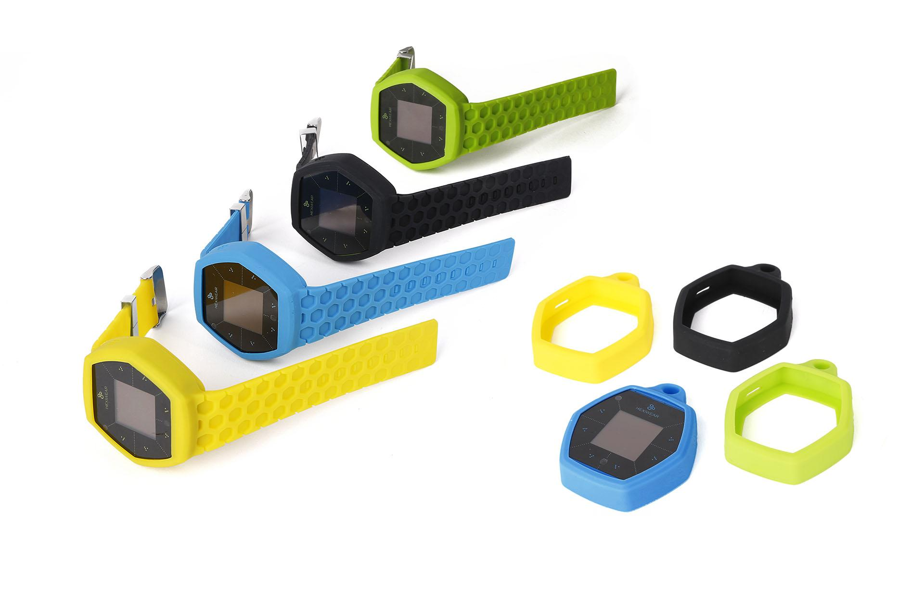

Hands-on Training

Slide 2
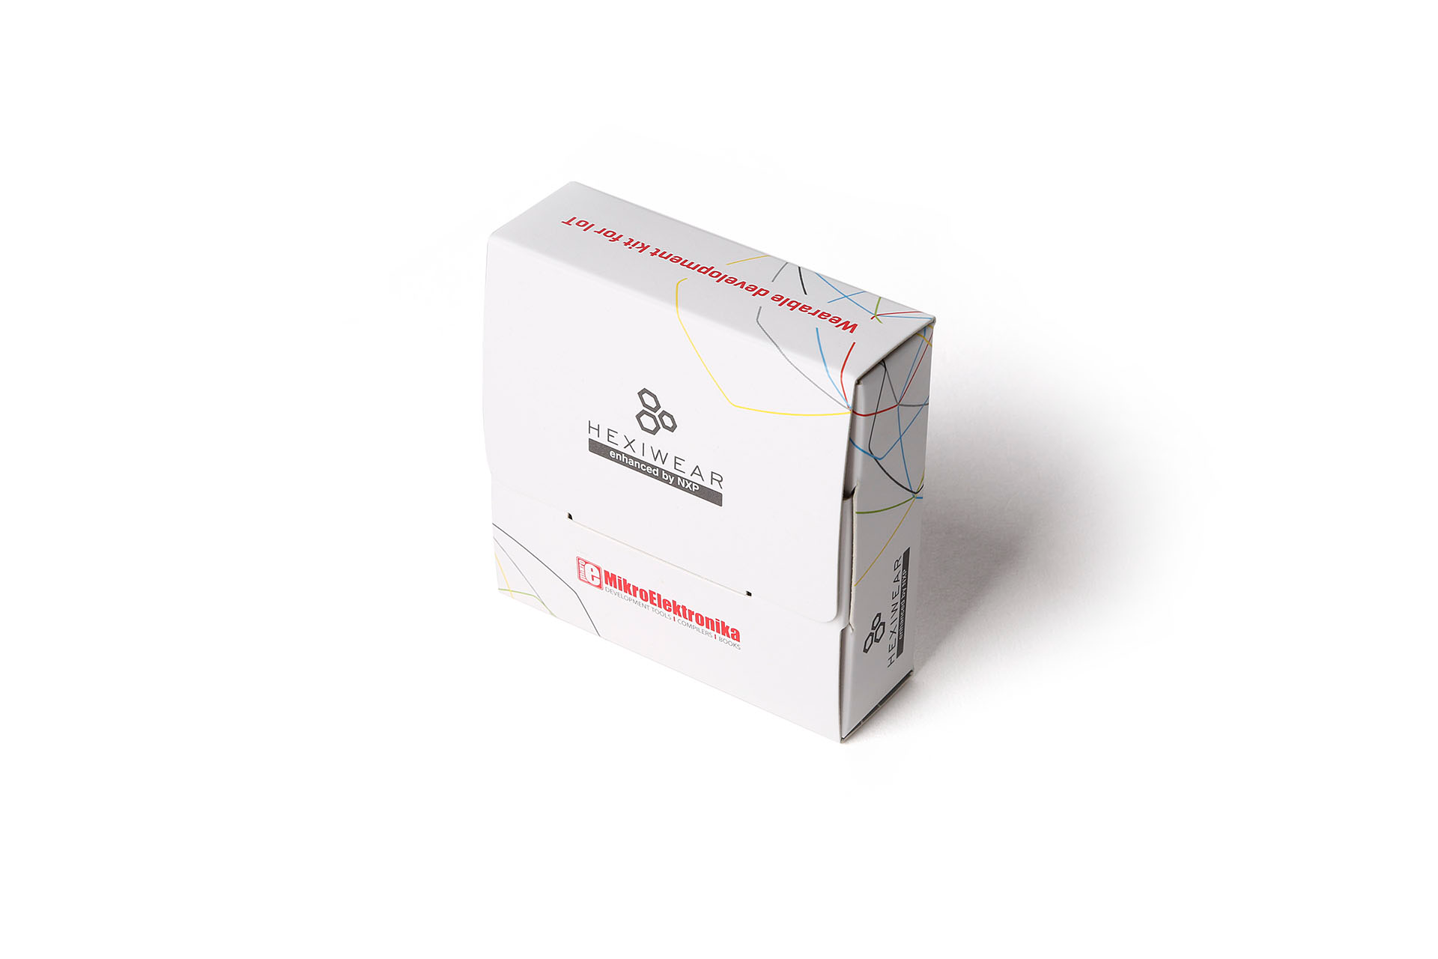
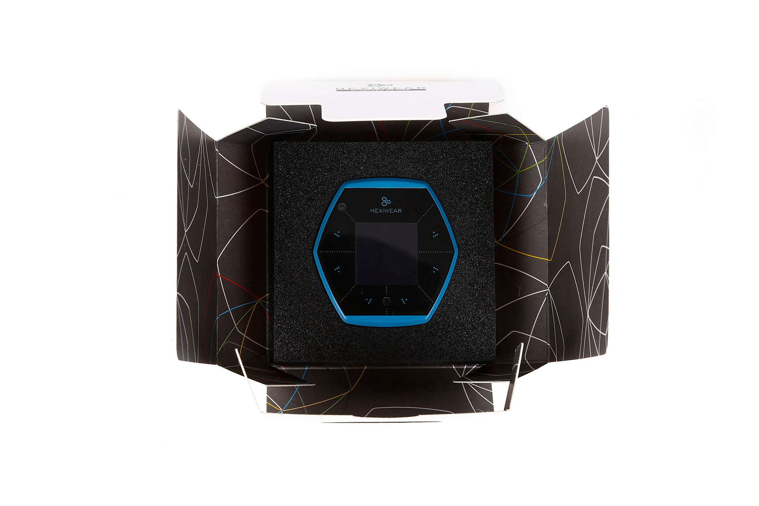
HEXIWEAR Single Box
Hexiwear is an optimized, powerful and versatile IoT development solution. A small and sleek, low-power device packed with sensors to quantify yourself and the world around you. Wirelessly enabled, it can connect both to devices nearby or to remote cloud servers.

Slide 3
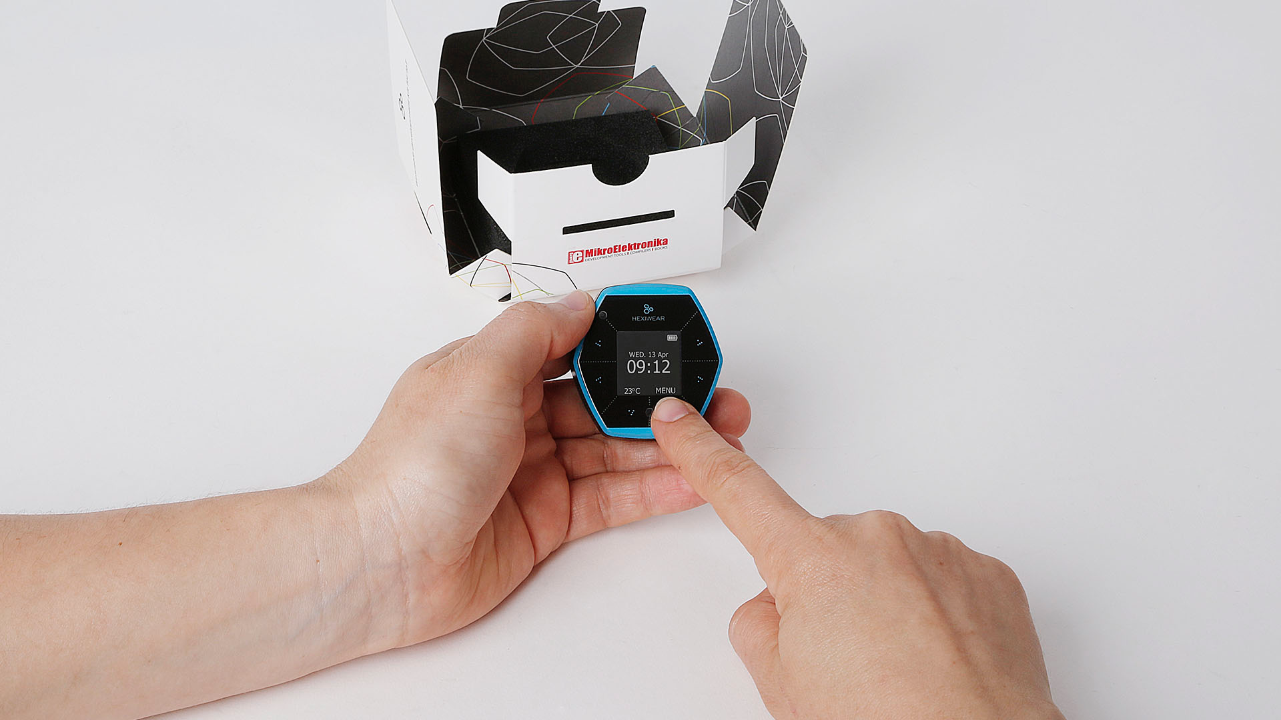
Double tap to wake up

Slide 4
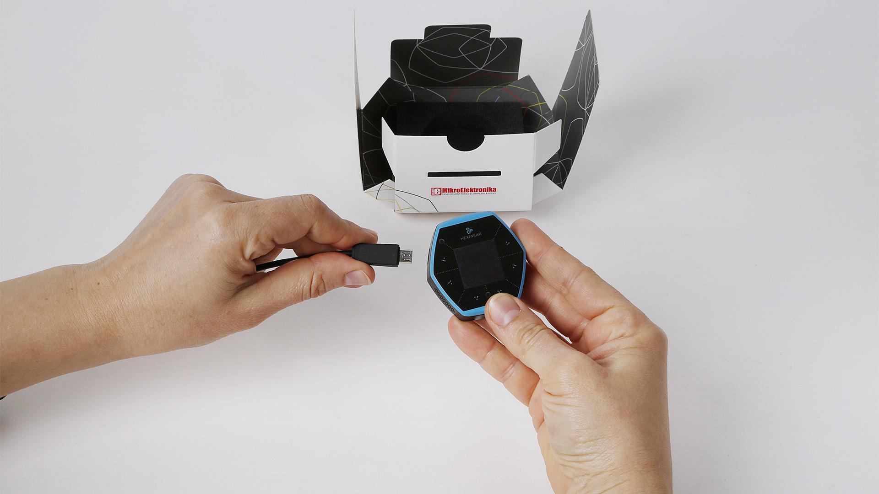
Plug Micro USB cable if the battery is empty

Slide 5
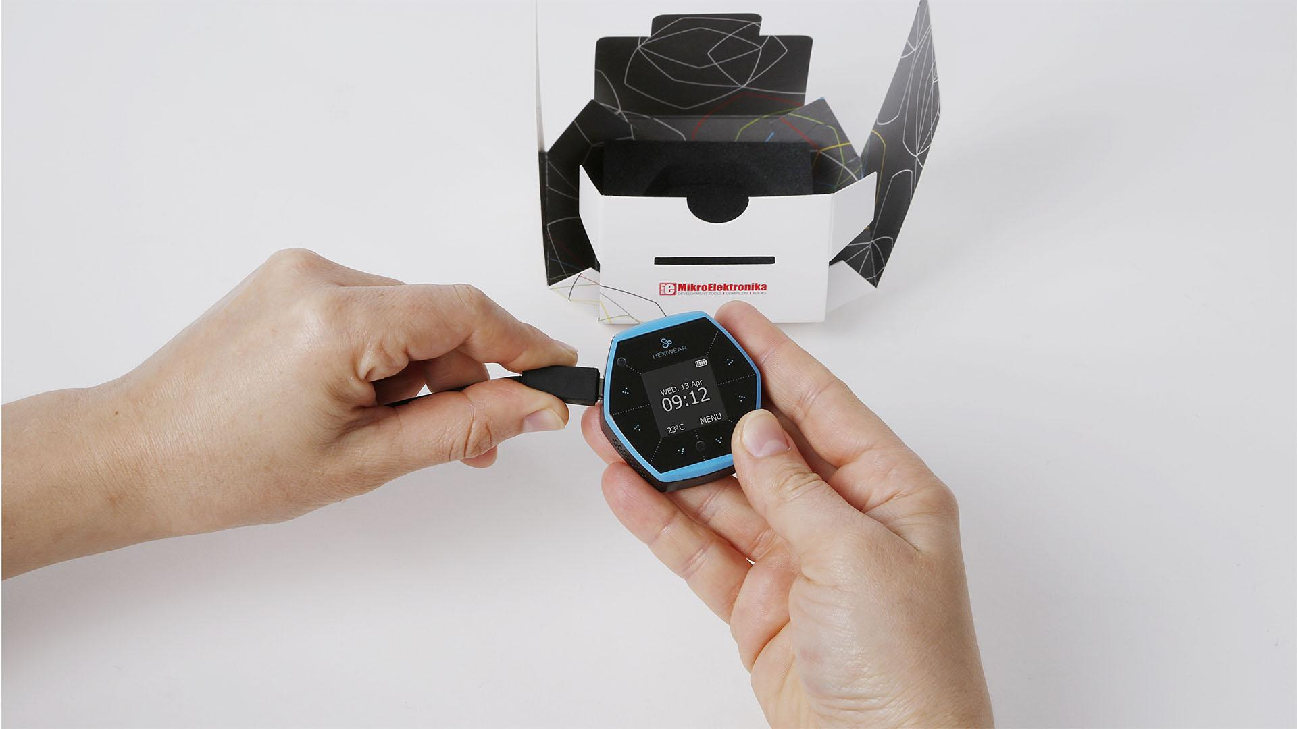
A single charge lasts for days

Slide 6
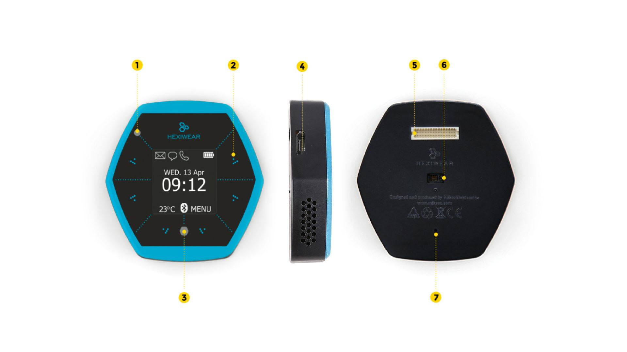
What you see
Ambient light sensor
Capacitive buttons surrounding the central OLED display
RGB LED
Micro USB Port
Hexiwear Docking Station connector
Optical heart rate sensor LED and photodiode
Reset button

Slide 7
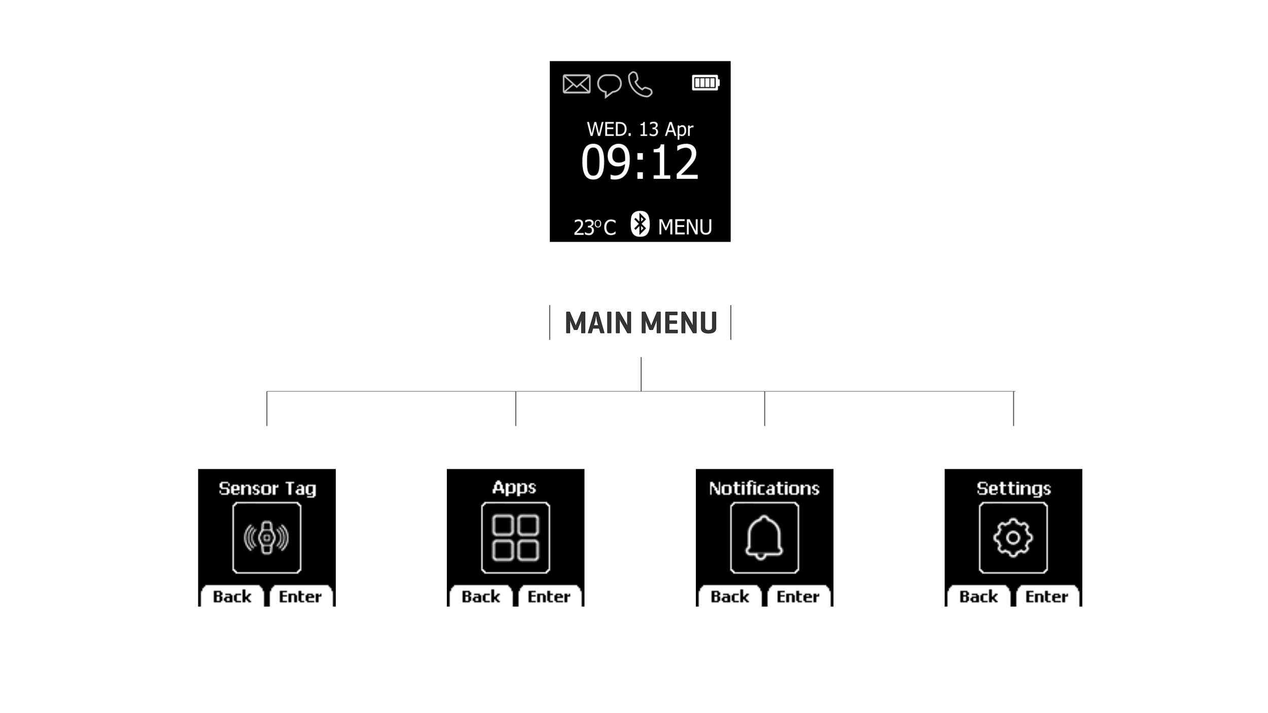
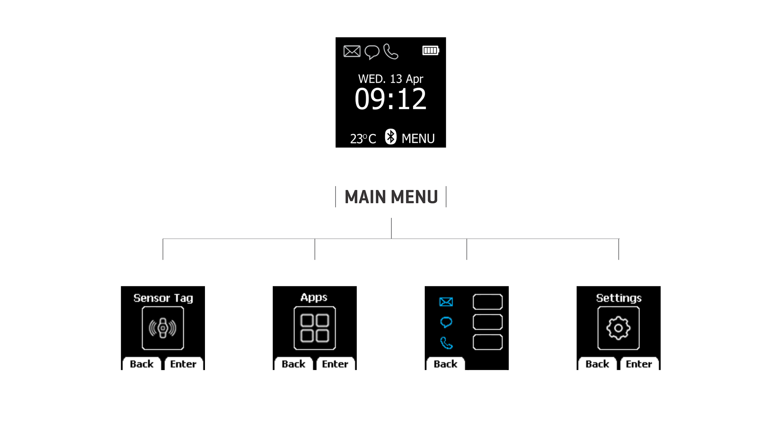
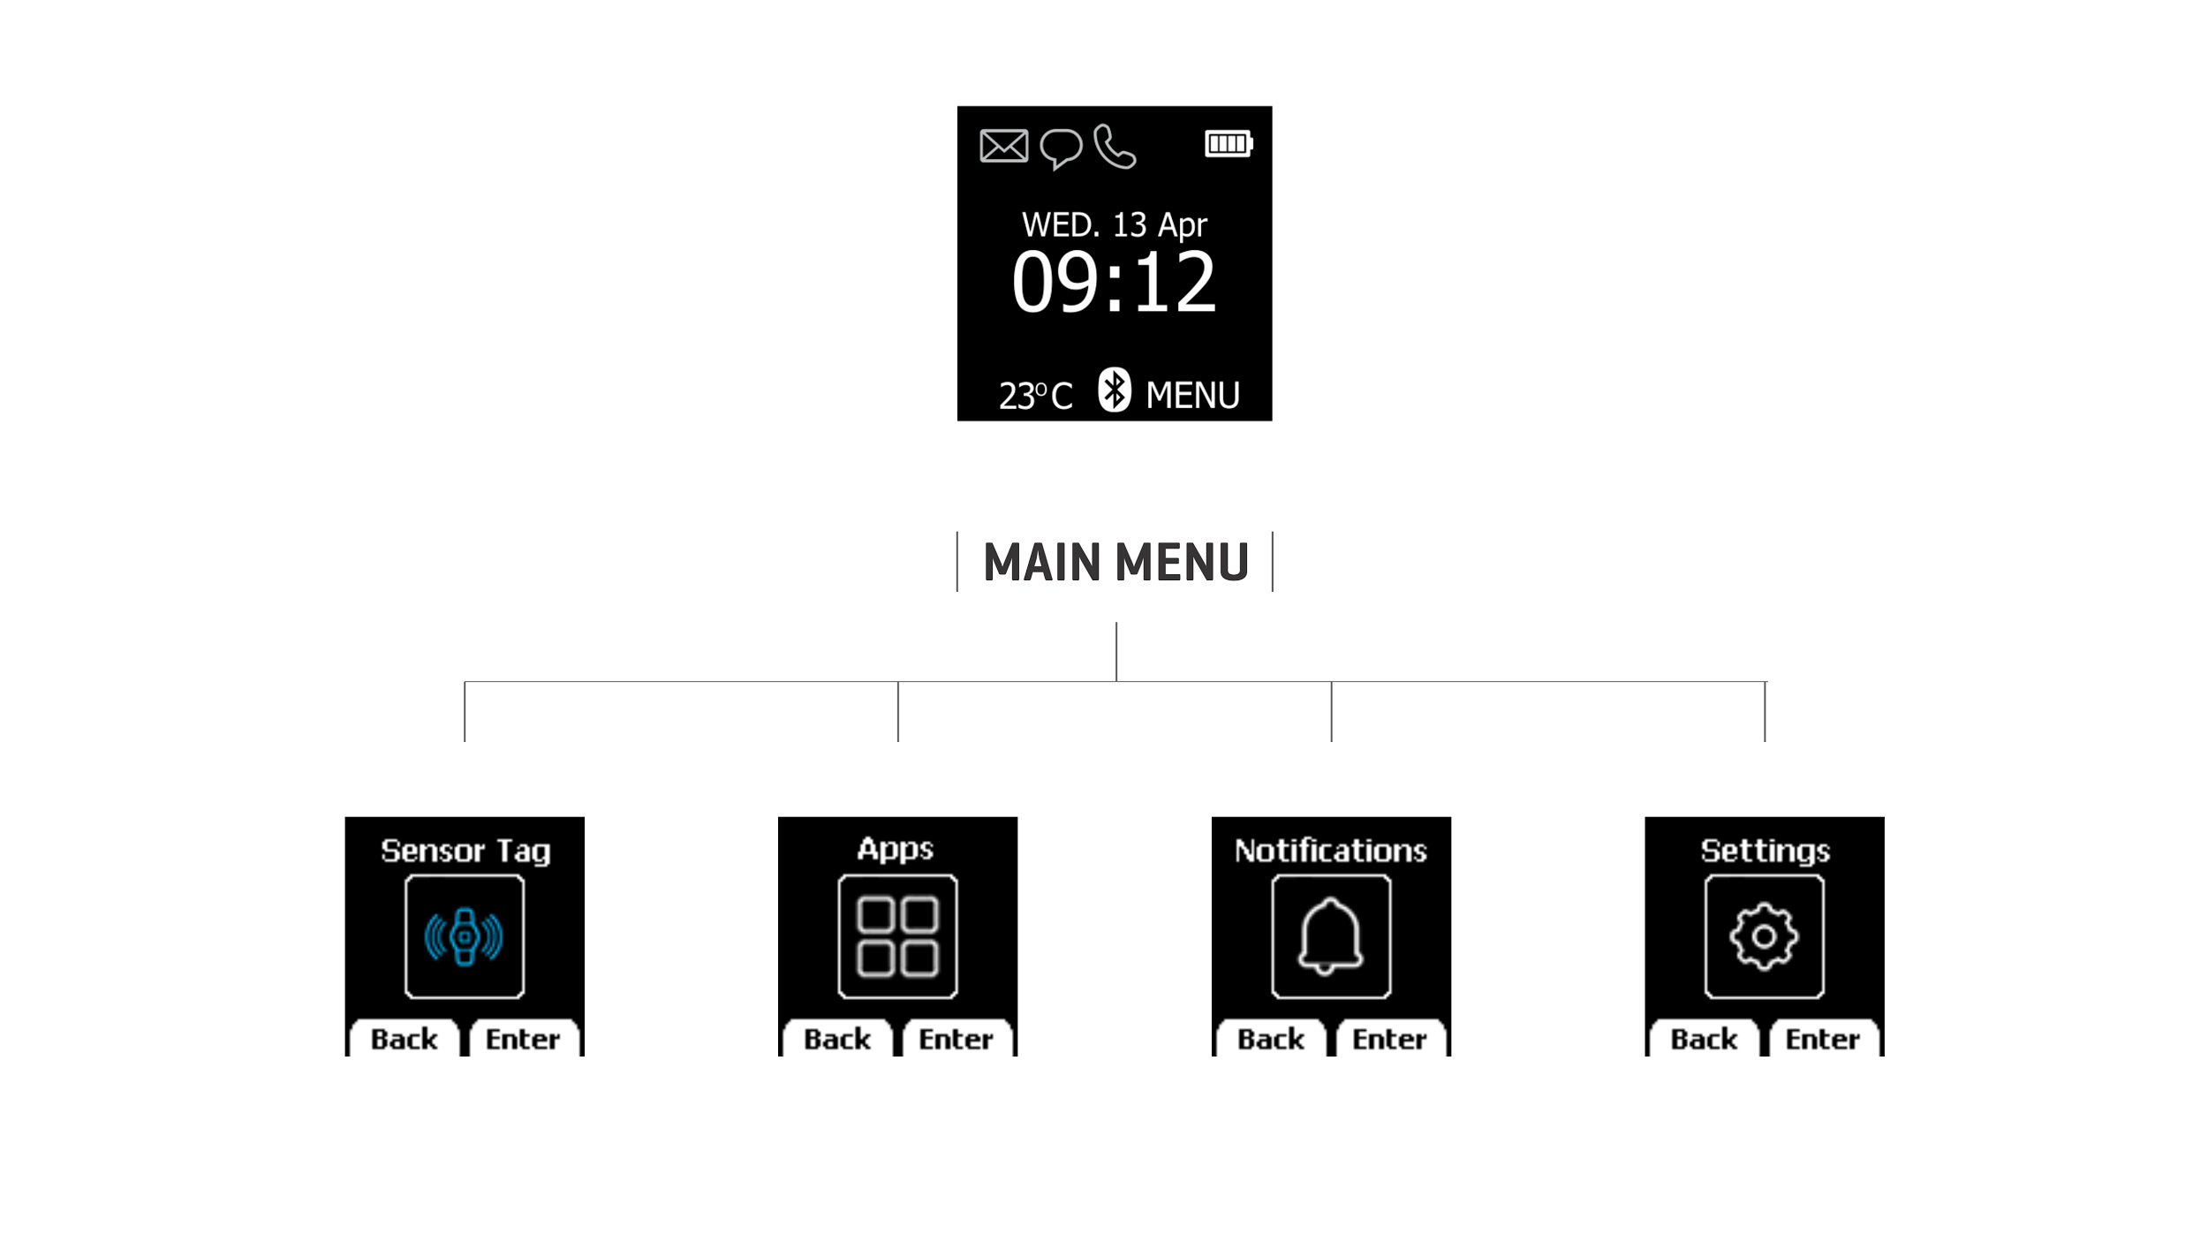
Hexiwear menu

Slide 8
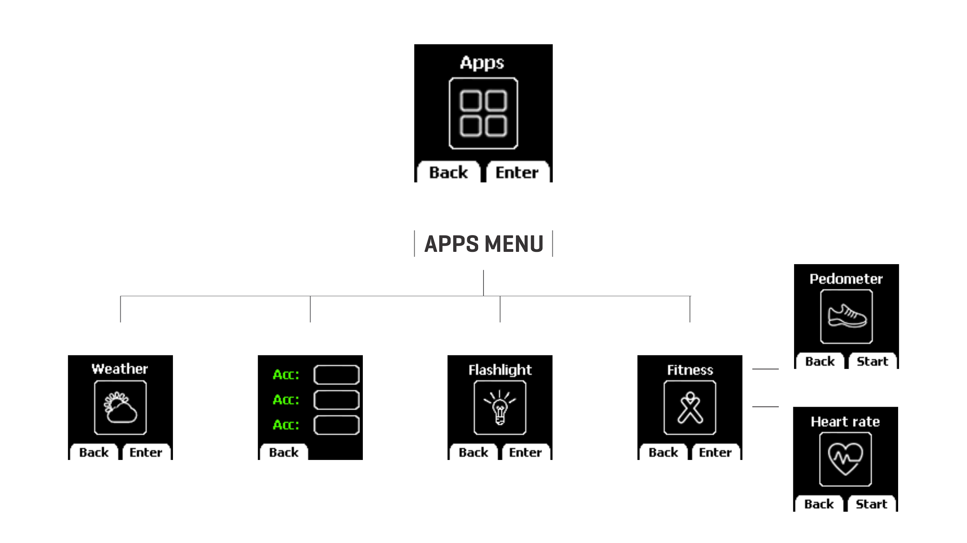

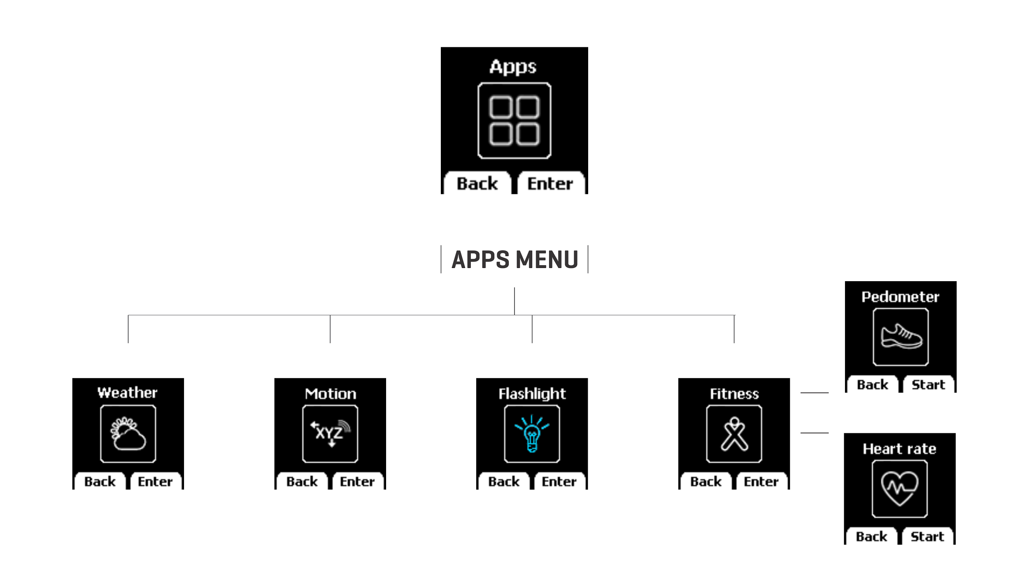
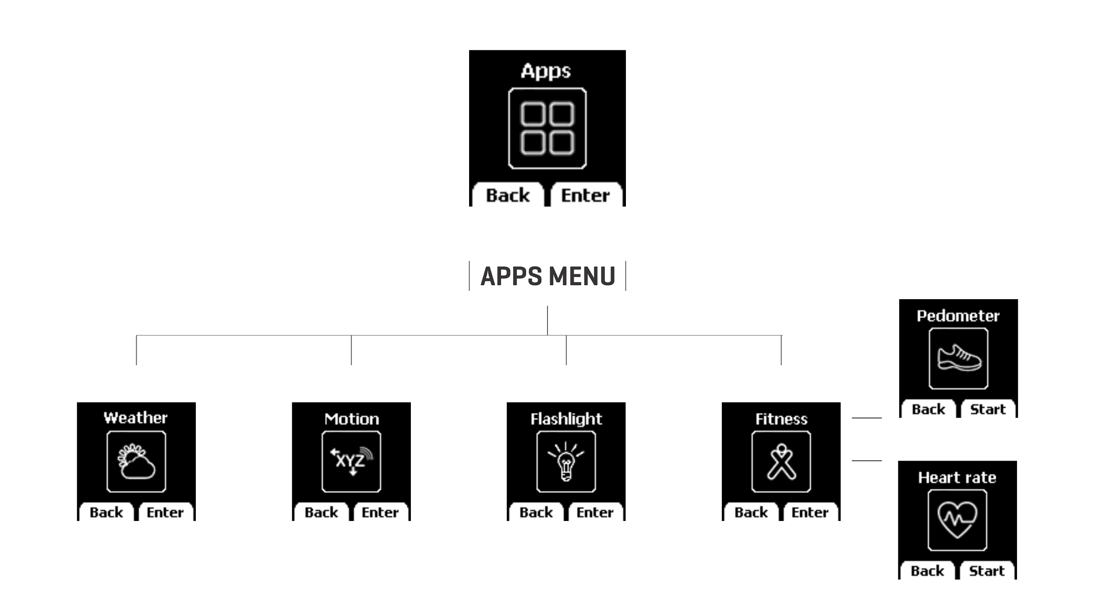
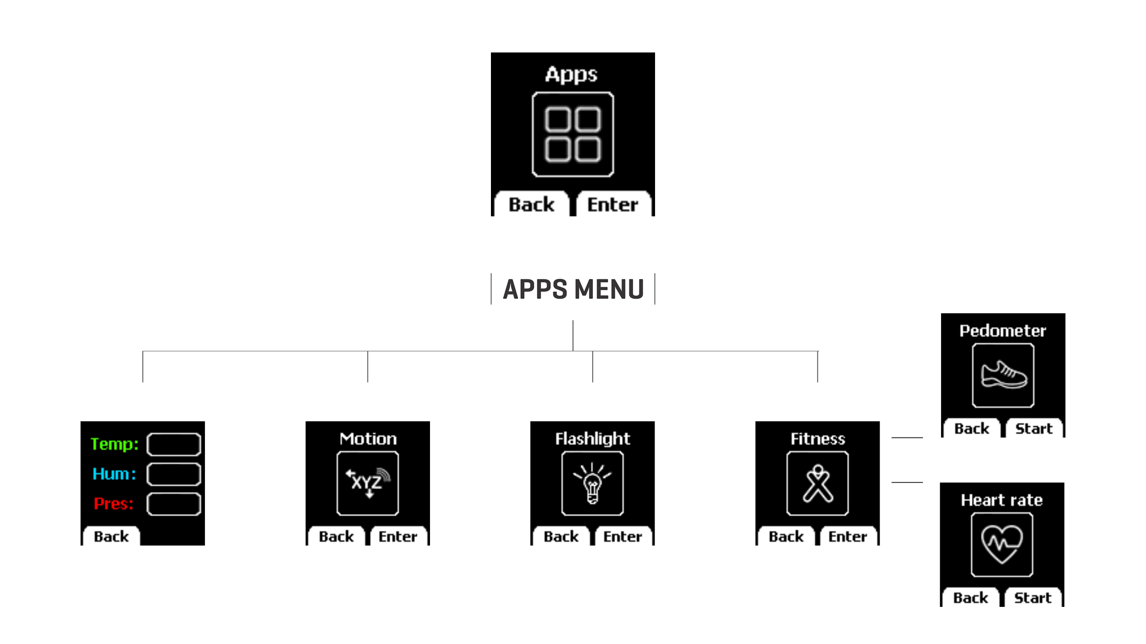
Hexiwear menu

Slide 9
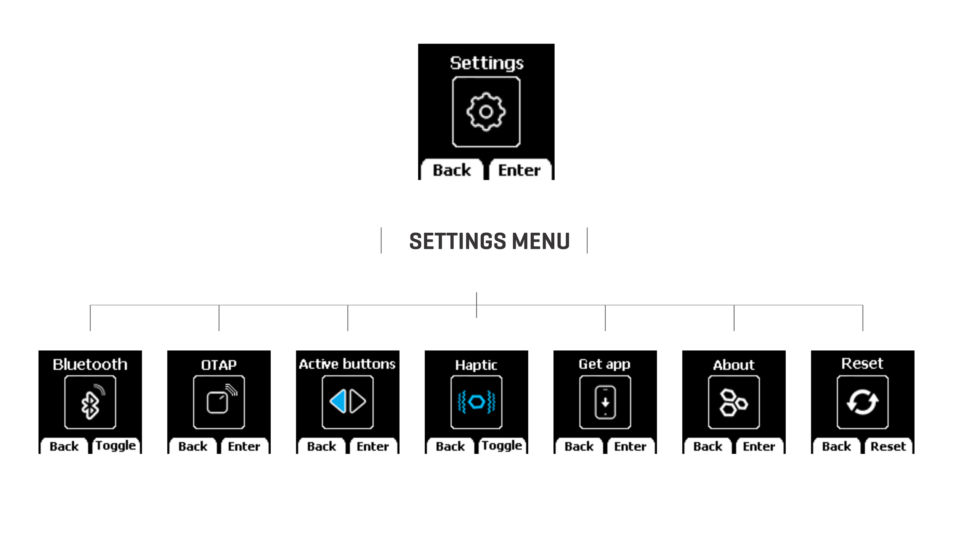
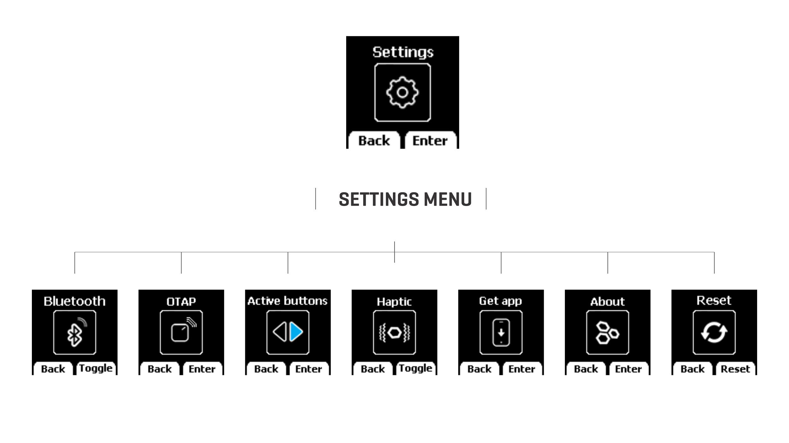
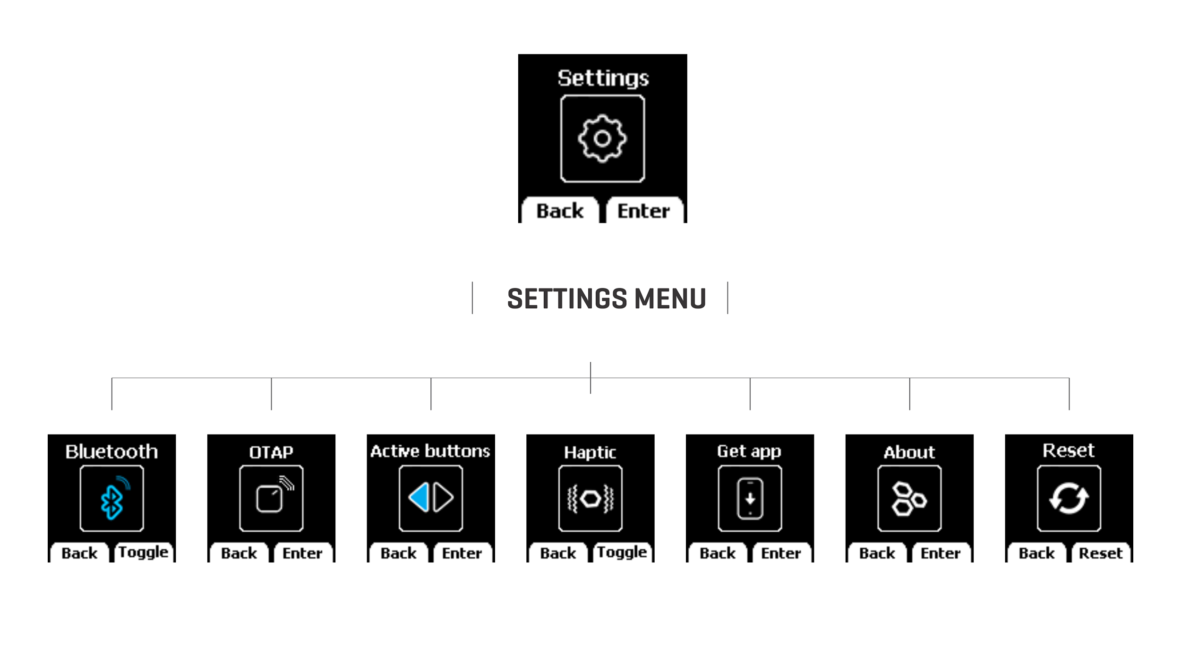
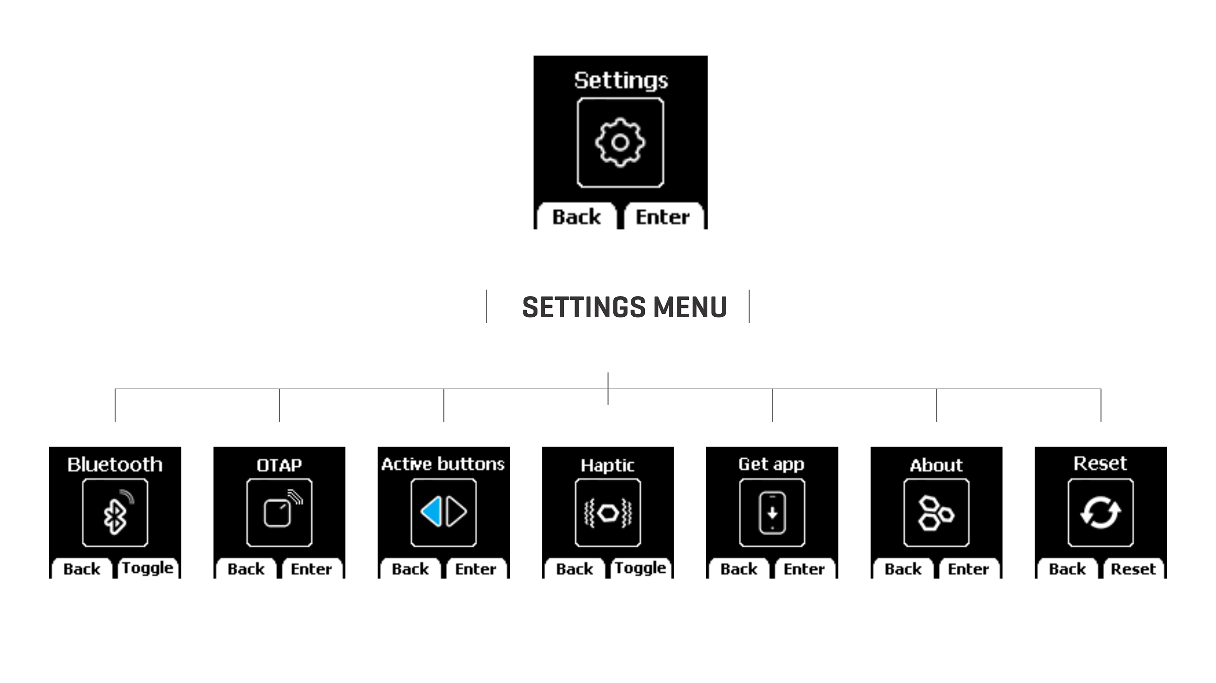
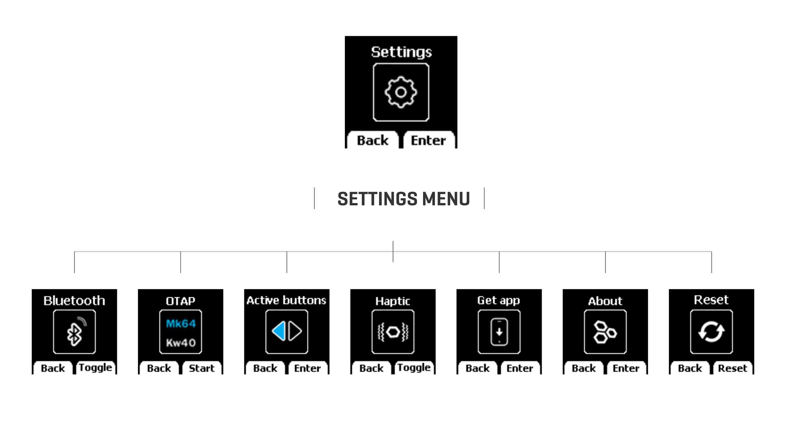
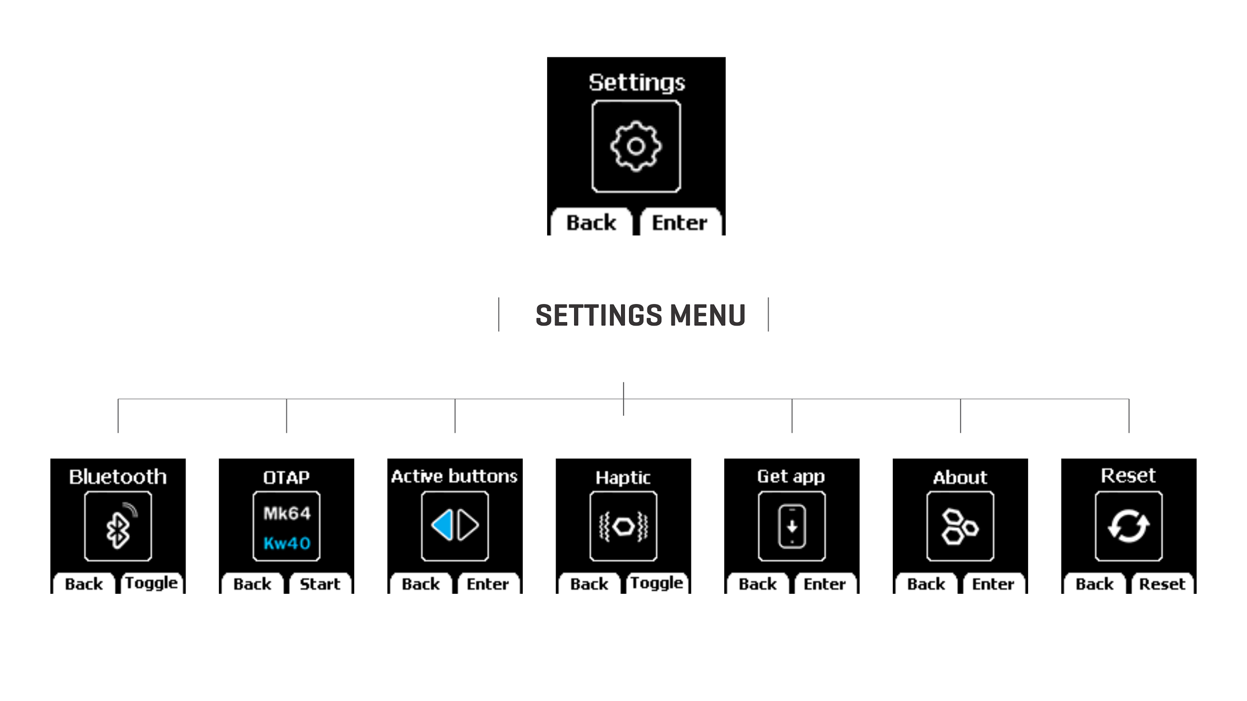
Hexiwear menu

Slide 10
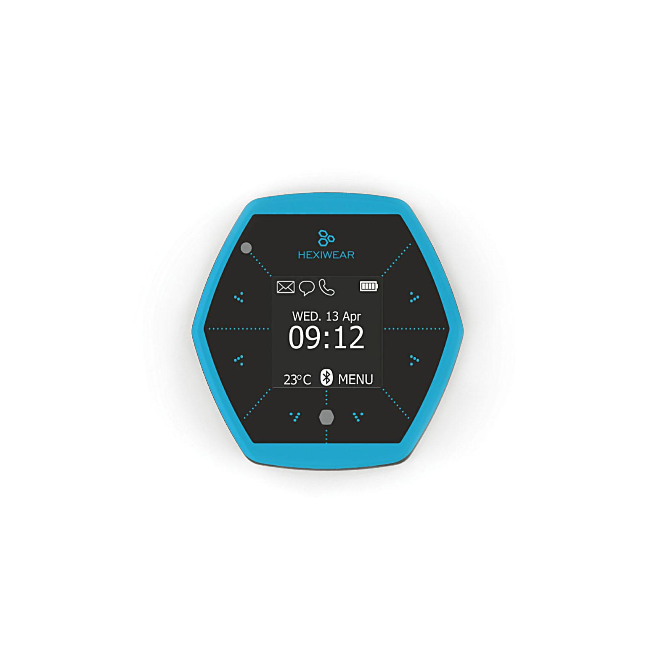

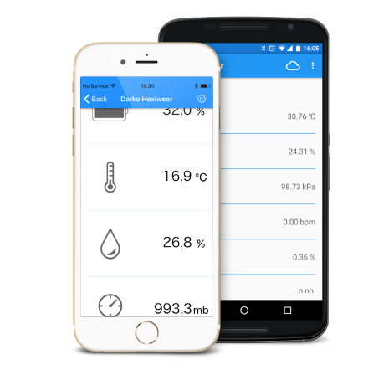

HEXIWEAR Smartphone Apps
Bluetooth 4.0 required

Slide 11

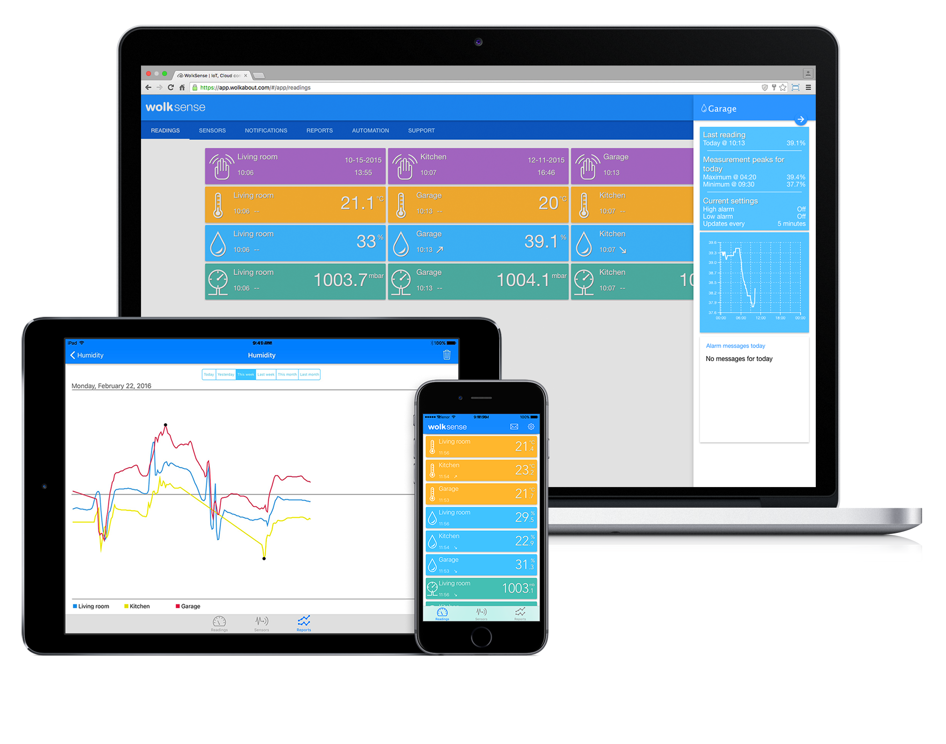
HEXIWEAR Cloud

Slide 12
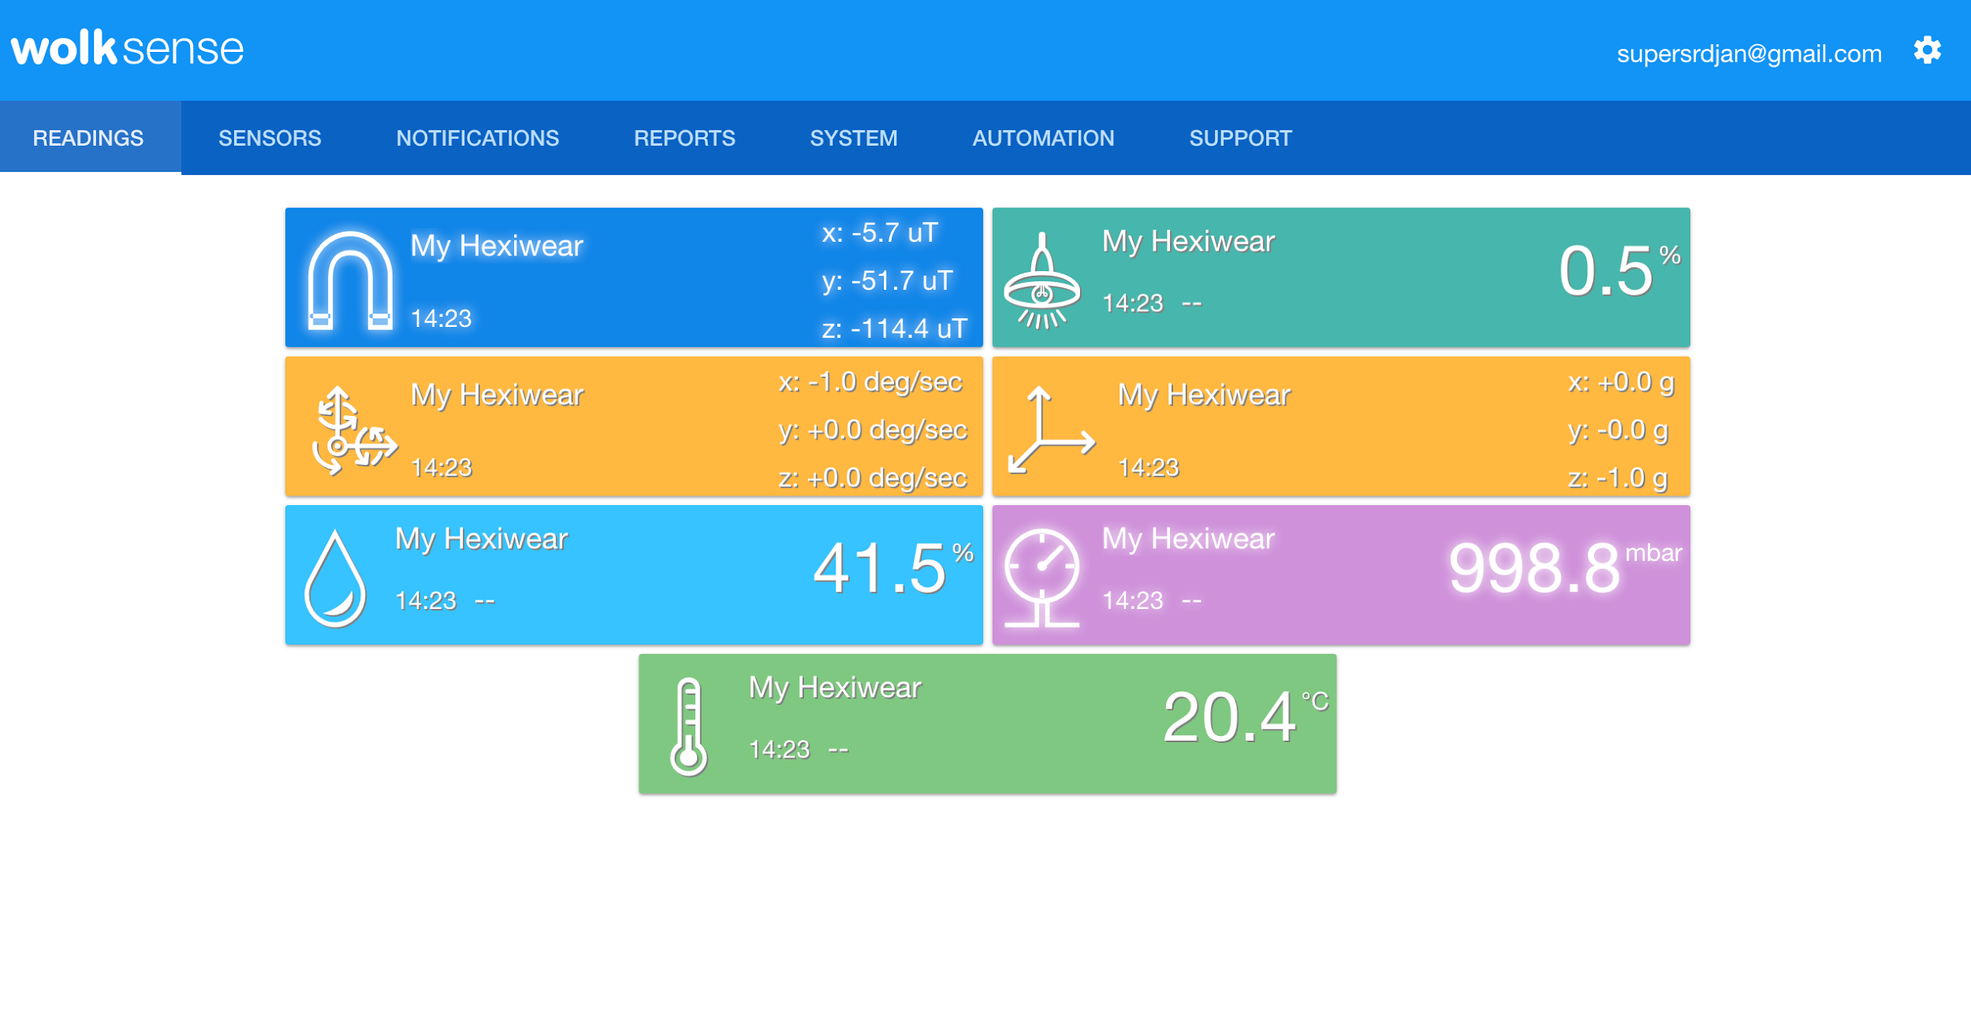
HEXIWEAR Cloud
app.wolksense.com

Slide 13
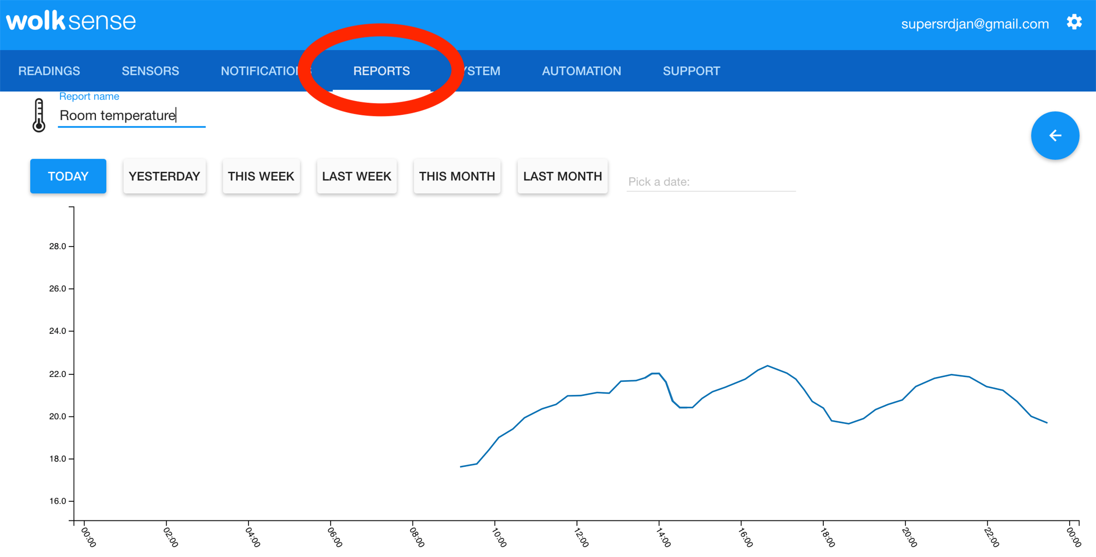
HEXIWEAR Cloud – log sensor data and generate reports

Slide 14
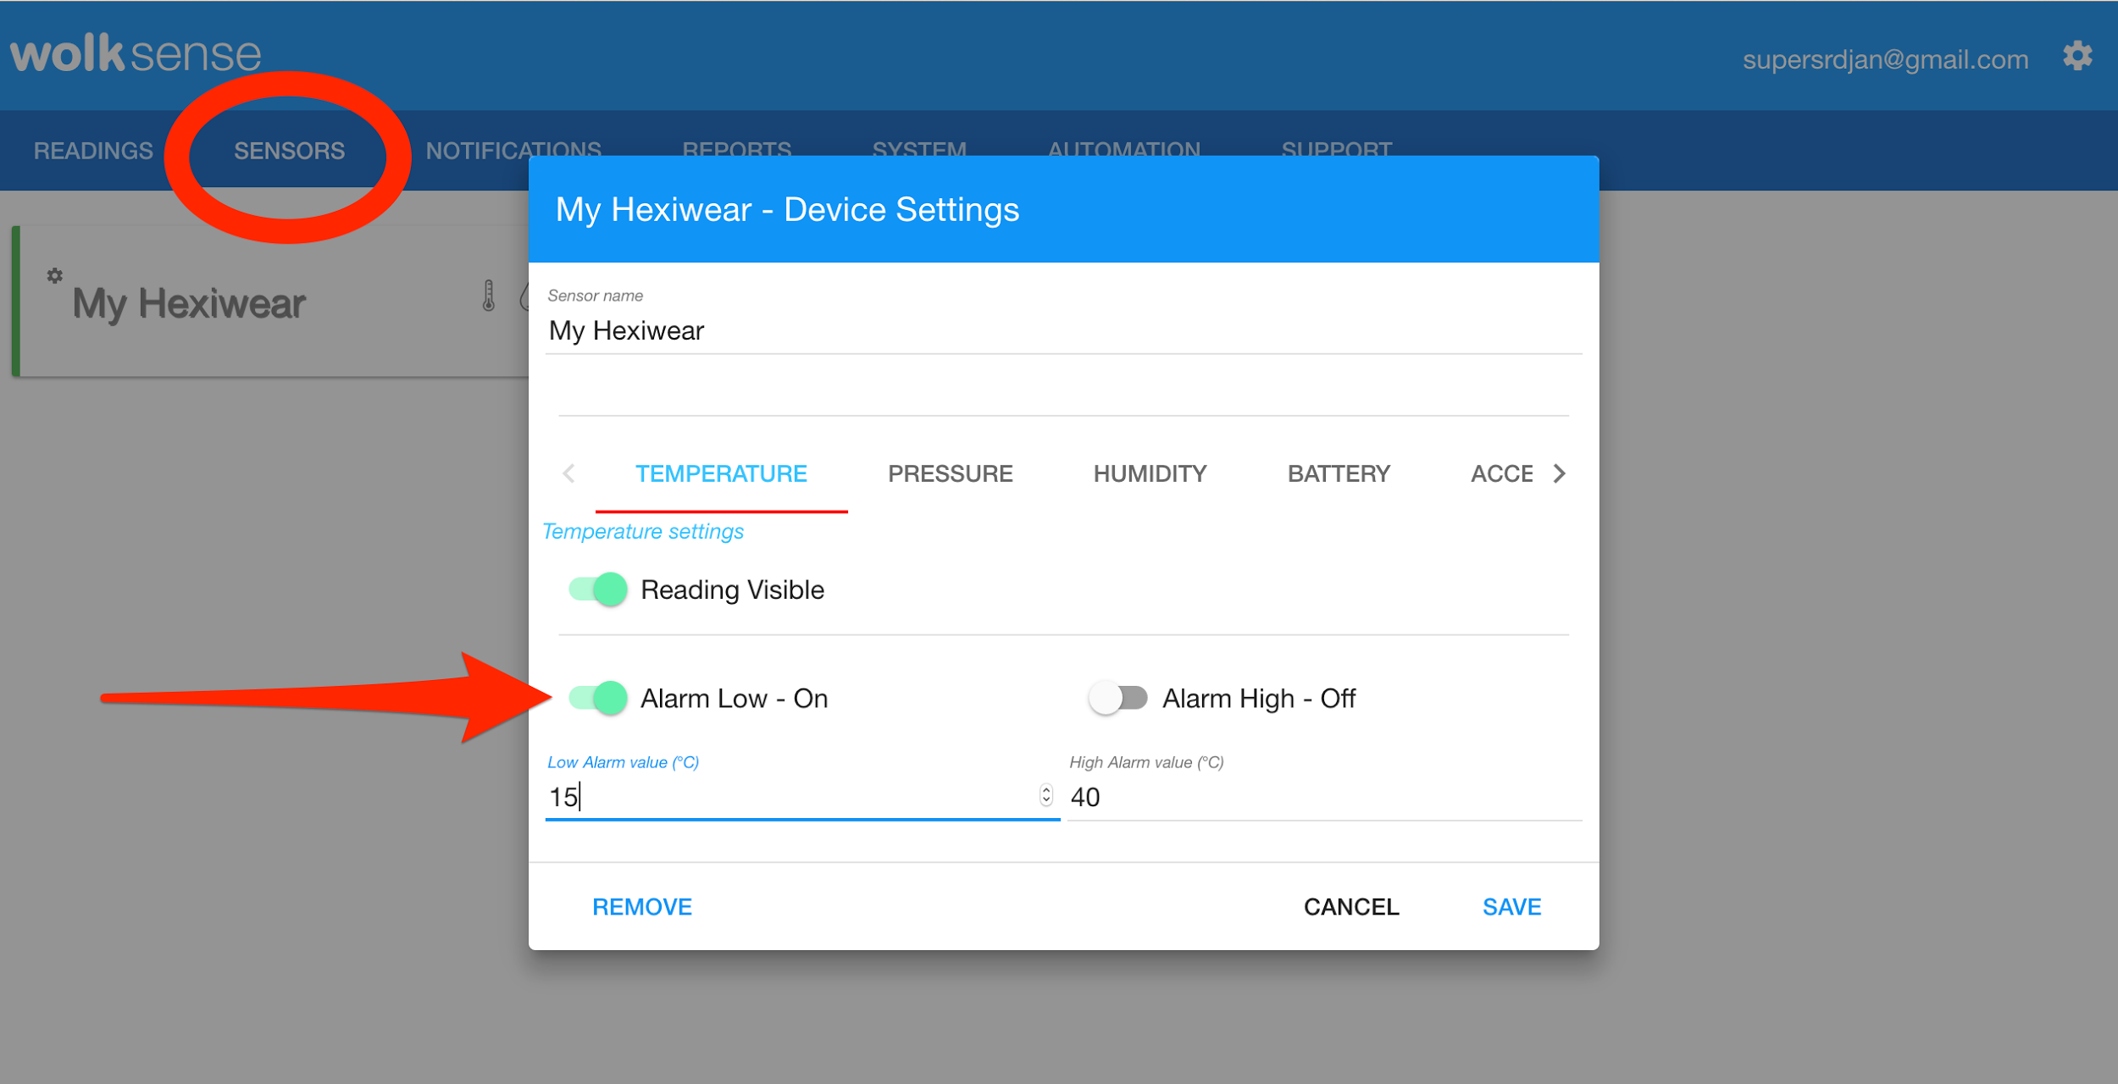
HEXIWEAR Cloud – set up alarms

Slide 15
HEXIWEAR Block Diagram

Slide 16
HEXIWEAR Block Diagram
MK64
UART
KW40
GPIO

Slide 17
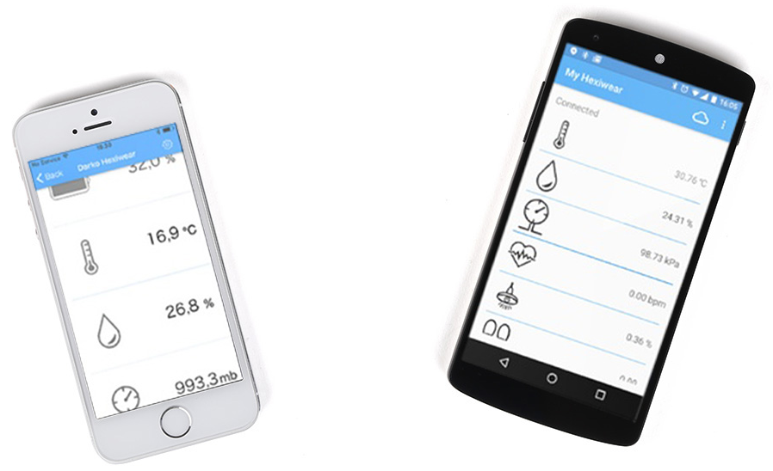
HEXIWEAR Block Diagram
Touch
electrodes
MK64
UART
KW40
GPIO
BLE

Slide 18
HEXIWEAR Block Diagram
Touch
electrodes
Battery
LEDs
GPIO
ADC
OLED
display
MK64
UART
KW40
SPI
GPIO
haptic
GPIO
BLE
I2C
bar
acc
HR
gyro
mag
lux
hum
temp

Slide 19
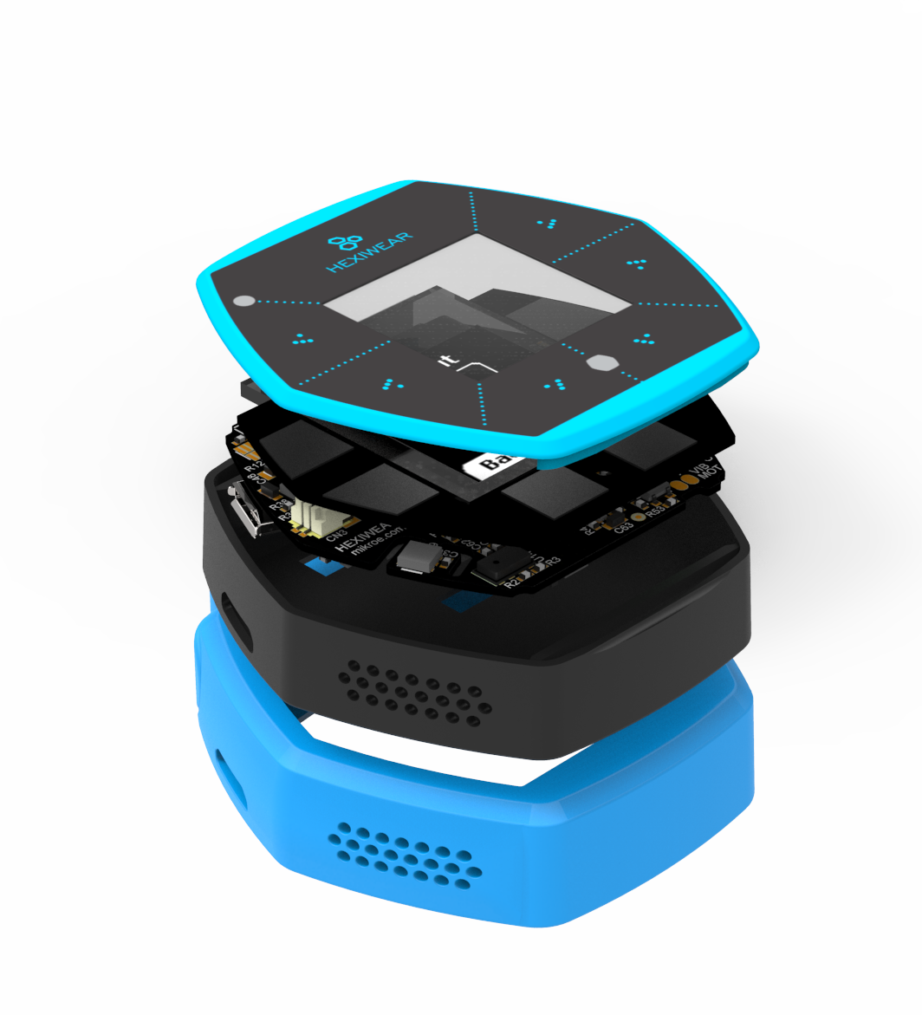
HEXIWEAR Teardown
Front Mask
CapSense Electrodes
Main PCB
Casing
Protective Soft Cover

Slide 20
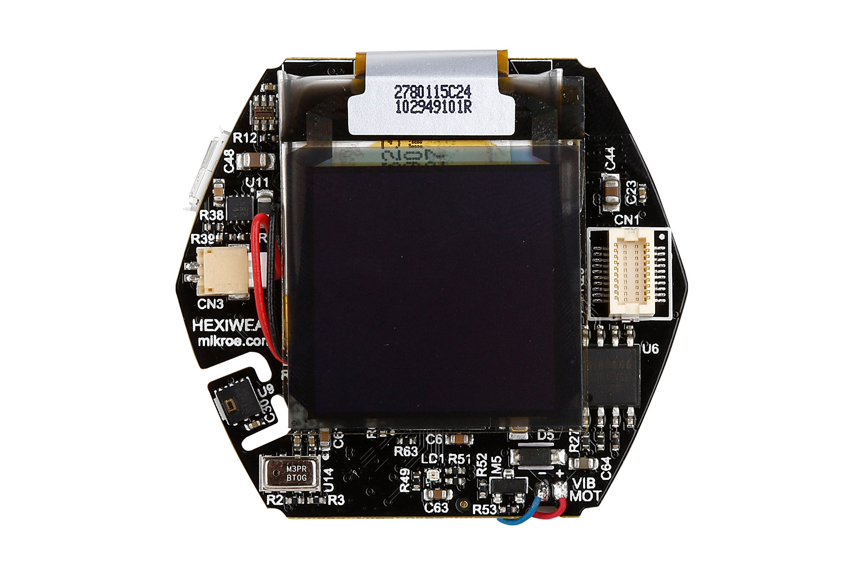
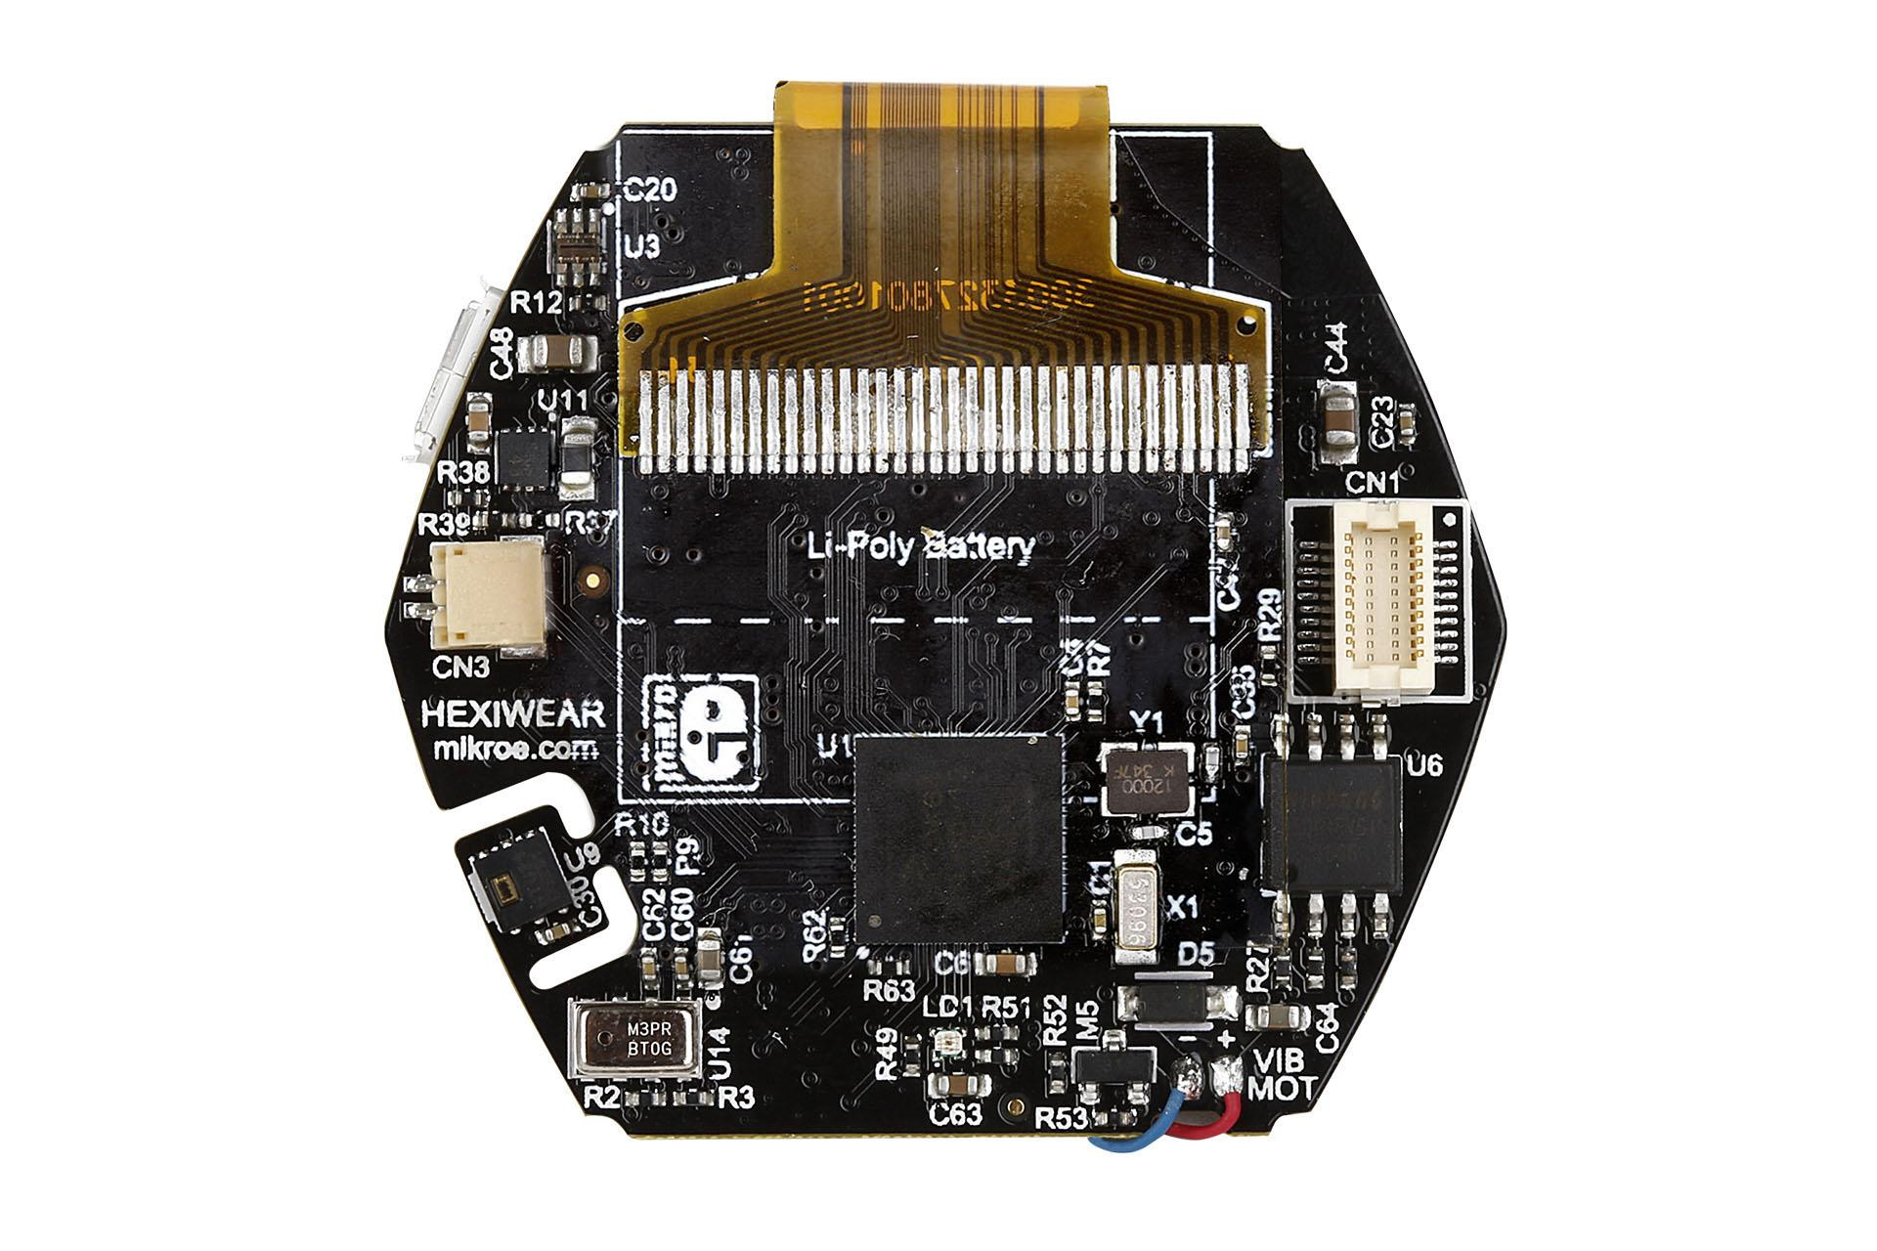
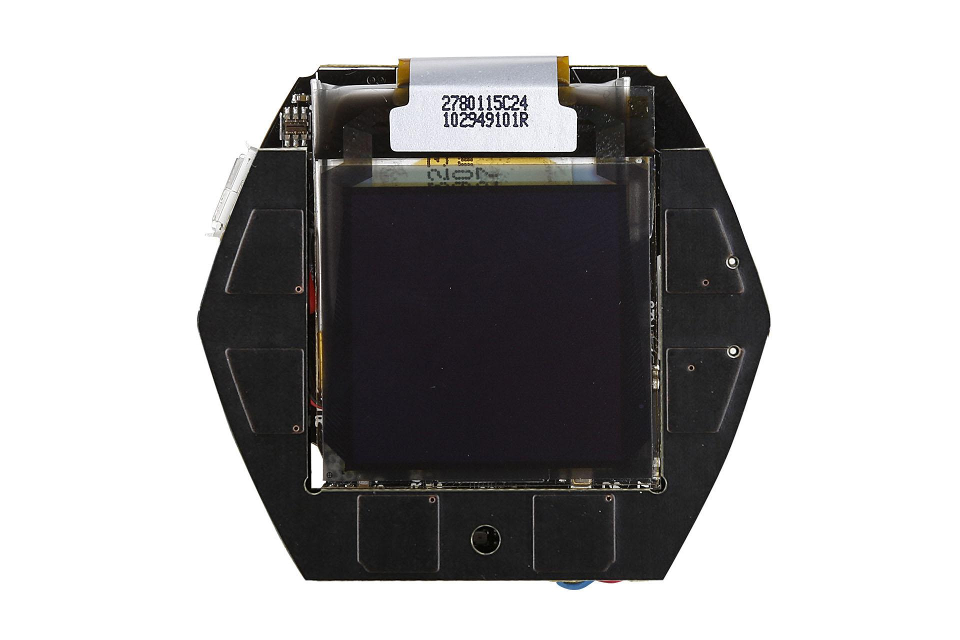
HEXIWEAR Teardown
TSL2561
SSD1351
OLED Screen
96 ⨉ 96 Resolution
Up to 262k colors
Parallel and SPI Interface
Vertical/Horizontal Scrolling
Charging
CapSense Adapter
Serial FLASH
CapSense Electrodes
HTU21D(F)
MPL3115A2
MK64
RGB Diode

Slide 21
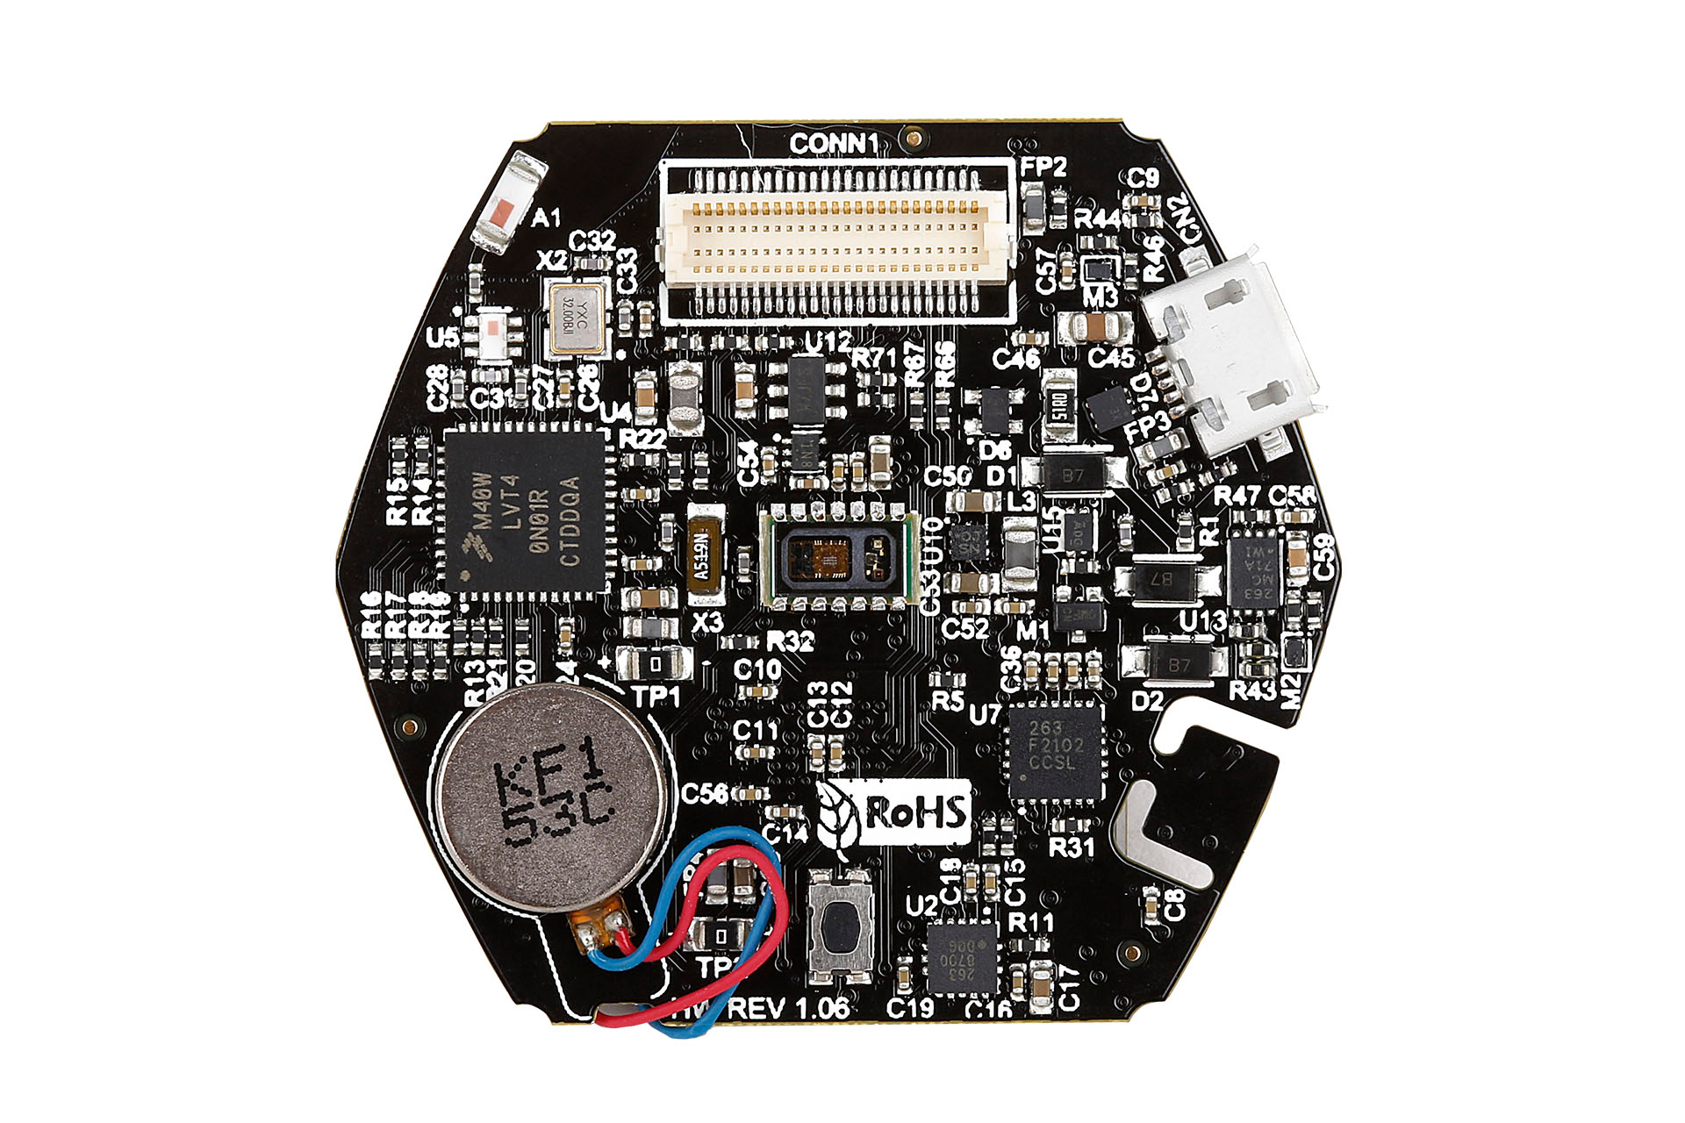
HEXIWEAR Teardown
Docking station connector
USB port
KW40
MAX30101
MC34671
FXAS21002
Haptic feedback
FXOS8700
Reset button

Slide 22

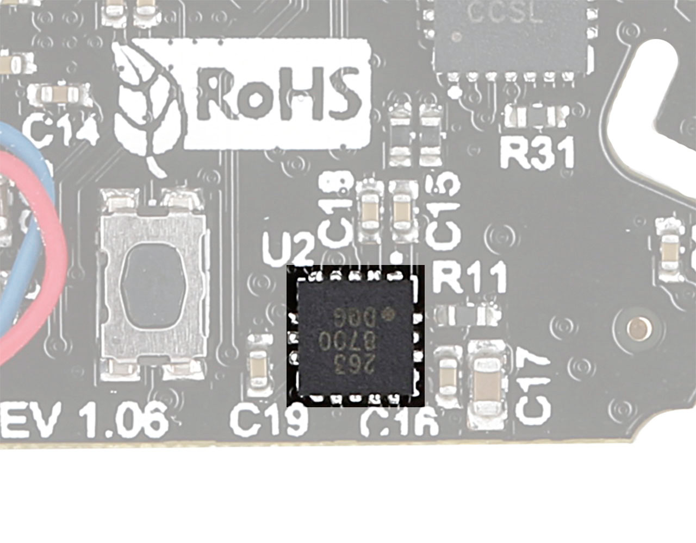
HEXIWEAR Sensors
FXOS8700CQ 6-Axis Sensor with Integrated Linear Accelerometer and Magnetometer
- ±2g/±4g/±8g dynamically selectable acceleration full-scale range - ±1200 µT magnetic sensor full-scale range - 14-bit / 16-bit ADC resolution for acceleration/magnetic measurements - Output data rates from 1.563 Hz up to 800 Hz per sensor and up to 400 Hz in hybrid mode (both sensors active) - Supports I2C/SPI interface - Low noise - Low power: 80 μA @ 25 Hz - 240 μA @ 100 Hz (both sensors active) - Embedded programmable acceleration/magnetic event functions (example: double-tap detection)
acc
mag
gyro
bar
hum
temp
lux
HR

Slide 23
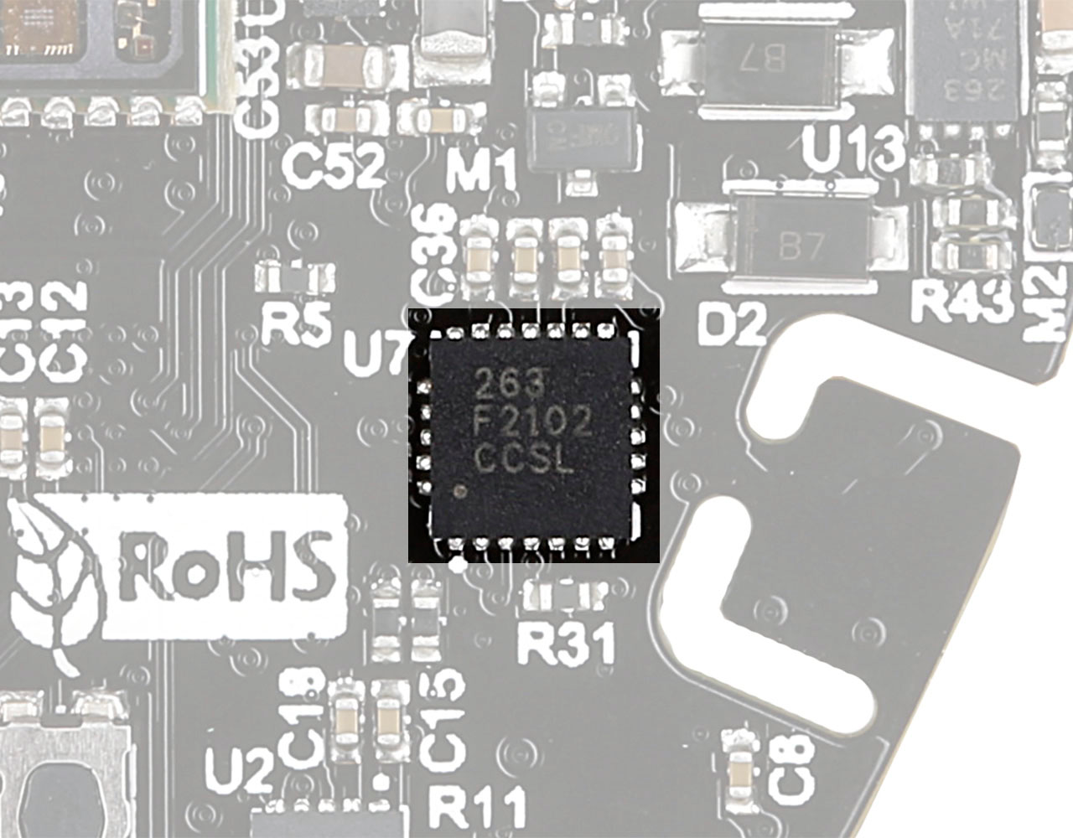
HEXIWEAR Sensors
FXAS21002C 3-Axis Digital Angular Rate Gyroscope
- Full-scale range from ±250°/s to ±2000°/s (optional boost function enables ranges up to ±4000°/s) - 16-bit ADC resolution - Output data rates from 12.5 to 800 Hz (with programmable low-pass filter to further limit digital output data bandwidth) - Supports I2C/SPI interface - Low noise - Low power standby mode - FIFO buffer: 192 bytes (32 X/Y/Z samples) with stop and circular operating modes - Rate Threshold interrupt function
acc
mag
gyro
bar
hum
temp
lux
HR

Slide 24
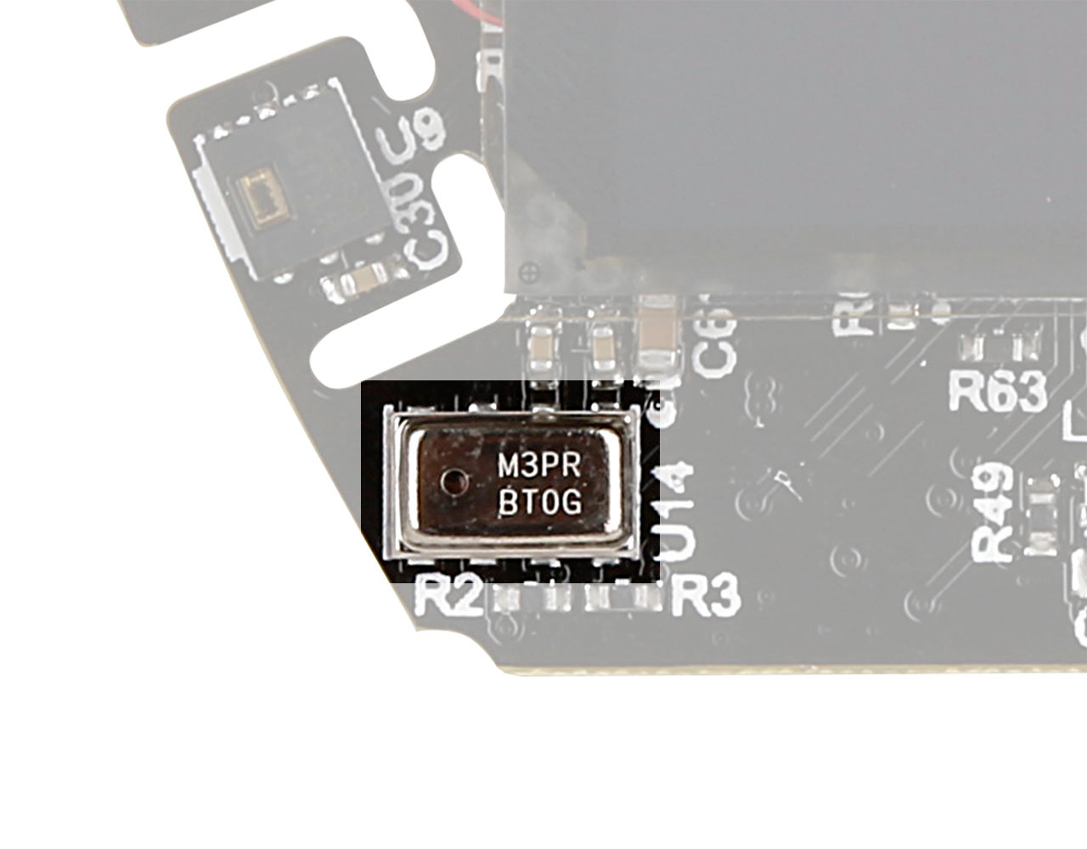
HEXIWEAR Sensors
MPL3115A2 Precision Altimeter
- Full-scale range from ±250°/s to ±2000°/s (optional boost function for up to ±4000°/s) - Resolution: – Pressure: 20-bit measurement (Pascals) – Altitude: 20-bit measurement (meters) – Temperature: 12-bit measurement (degrees Celsius) - Data acquisition rate from 1 second to 9 hours - Low noise - Low power standby mode - Supports I2C interface - FIFO buffer: 32-Samples - Programmable Events
acc
mag
gyro
bar
hum
temp
lux
HR

Slide 25
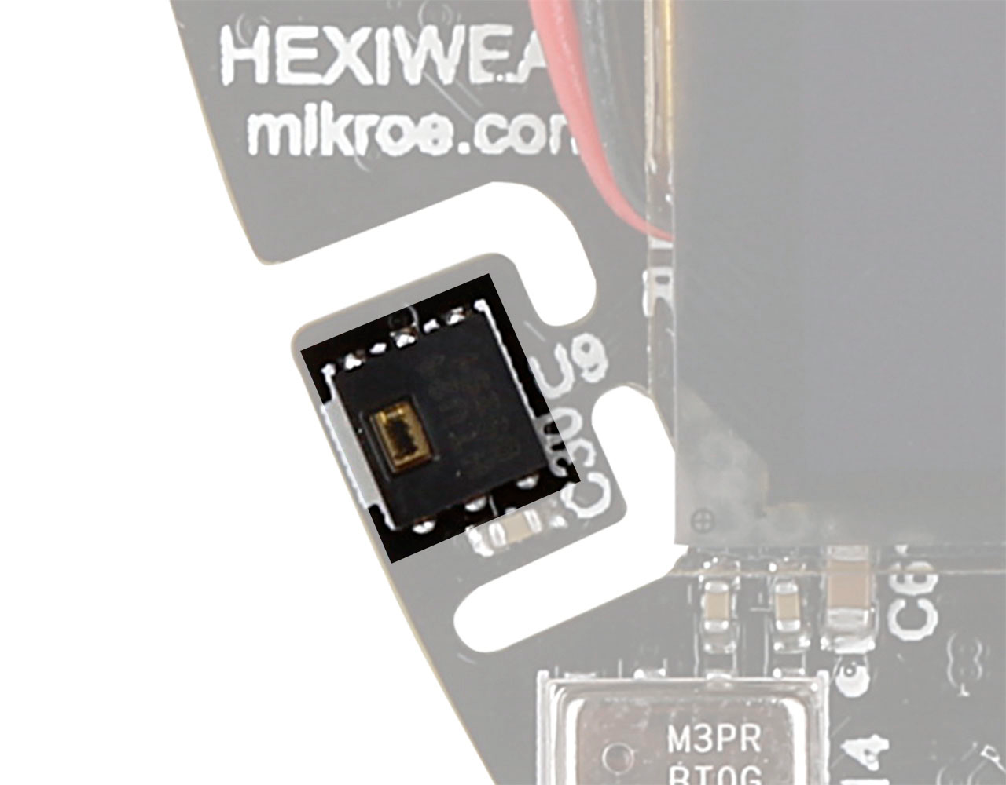
HEXIWEAR Sensors
HTU21D(F) Digital Relative Humidity sensor with Temperature output
- Resolution from 8-bit/12-bit up to 12-bit/14-bit for relative humidity and temperature measurements - Fully calibrated - Low power consumption - Supports I2C interface - Response time from 3 ms for the smallest resolutions up to 16 ms for the biggest resolutions - Optional membrane (F) protects the sensor against dust, water and contamination by particles
acc
mag
gyro
bar
hum
temp
lux
HR

Slide 26
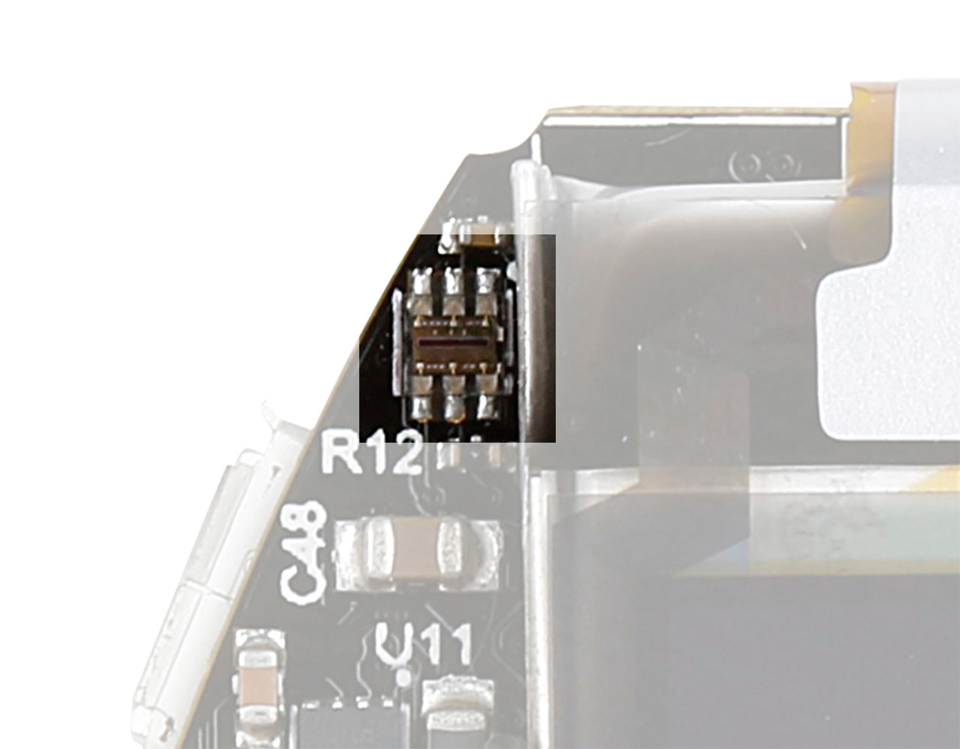
HEXIWEAR Sensors
TSL2561 Light-to-digital Converter
- Approximates human eye response - Programmable analog gain and integration time supporting 1,000,000-to-1 dynamic range - Automatically rejects 50/60-Hz lighting ripple - 16-bit Resolution - Supports I2C/SMBus interface - Low Active Power with Power Down Mode - Programmable Interrupt function with user-defined upper and lower threshold settings
acc
mag
gyro
bar
hum
temp
lux
HR

Slide 27
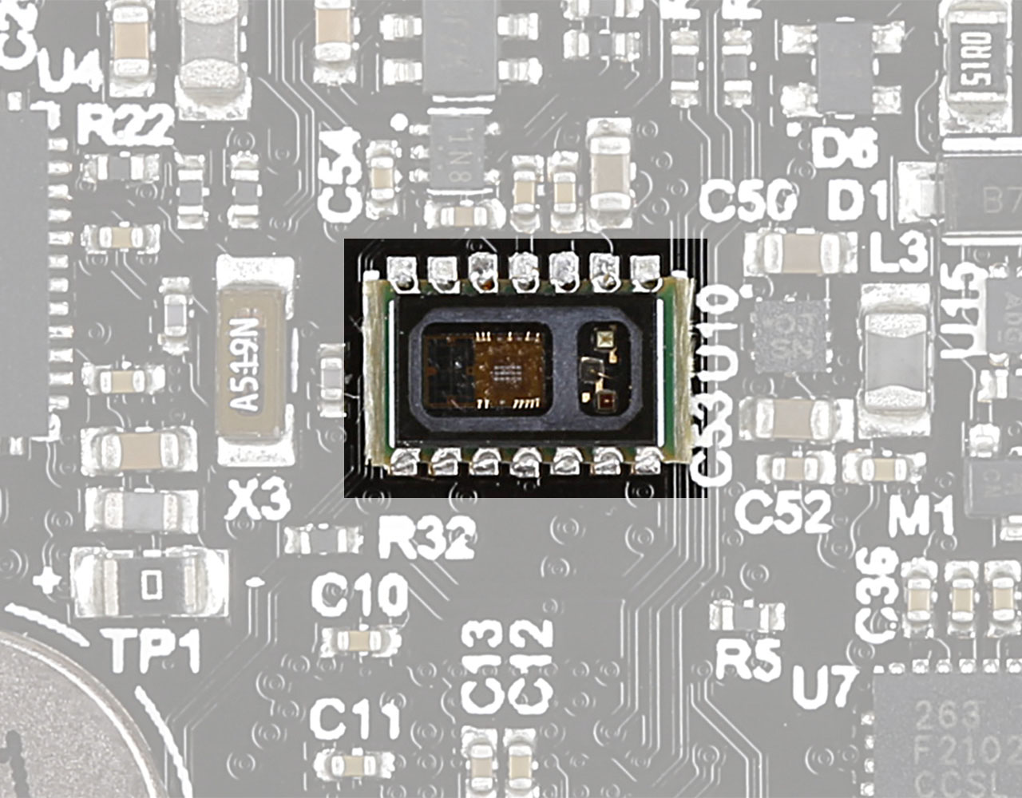
HEXIWEAR Sensors
MAX30101 High-Sensitivity Pulse Oximeter and Heart-Rate Sensor
- Includes internal LEDs - Fast Data Output Capability from 50 Hz up to 3200 Hz - 50Hz/60Hz interference and slow-moving residual ambient noise rejection - 18-bit Resolution - Supports I2C interface - Ultra-Low Power Operation - FIFO buffer (32 samples) - Robust Motion Artifact Resilience
acc
mag
gyro
bar
hum
temp
lux
HR

Slide 28

HEXIWEAR Firmware
IDE
STACK

Slide 29
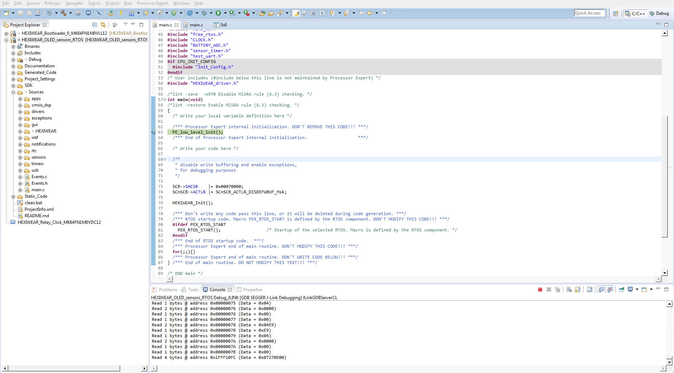
HEXIWEAR Firmware
IDE
STACK
Free Open-Source Eclipse-based IDE
utilizing GNU Compiler Collection (GCC) and GNU Debugger (GDB)

Slide 30

HEXIWEAR Firmware
IDE
STACK
Free-of-charge Software Support for NXPs ARM Cortex-M based MCUs

Slide 31
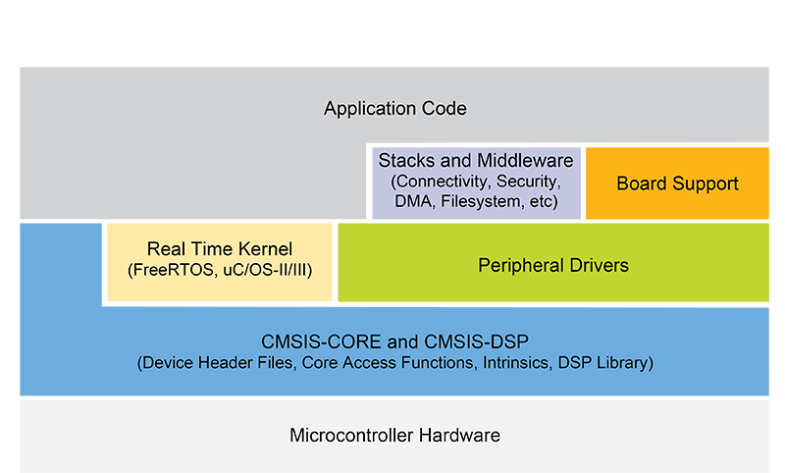
HEXIWEAR Firmware
HEXIWEAR
IDE
STACK
Kinetis SDK includes system startup, peripheral drivers, USB and connectivity stacks, middleware, and real-time operating system (RTOS) kernels.

Slide 32
HEXIWEAR Firmware
HEXIWEAR
IDE
STACK
MK64
Kinetis SDK 1.2:
Clock manager
DMA controller
Pin configuration
ADC
UART TX & RX
I2C
SPI
Power manager

Slide 33
HEXIWEAR Firmware
HEXIWEAR
IDE
STACK
MK64
Kinetis SDK 1.2:
Clock manager
DMA controller
Pin configuration
ADC
UART TX & RX
I2C
SPI
Power manager
FreeRTOS V8.0.0

Slide 34
HEXIWEAR Firmware
HEXIWEAR
IDE
STACK
KW40

Slide 35
HEXIWEAR Firmware
HEXIWEAR
IDE
STACK
KW40
Kinetis SDK 1.3:

Slide 36
HEXIWEAR Firmware
HEXIWEAR
IDE
STACK
KW40
FreeRTOS V8.2.0
Kinetis SDK 1.3:

Slide 37
HEXIWEAR Firmware
HEXIWEAR
IDE
STACK
KW40
KW40Z Connectivity Software
FreeRTOS V8.2.0
Kinetis SDK 1.3:

Slide 38
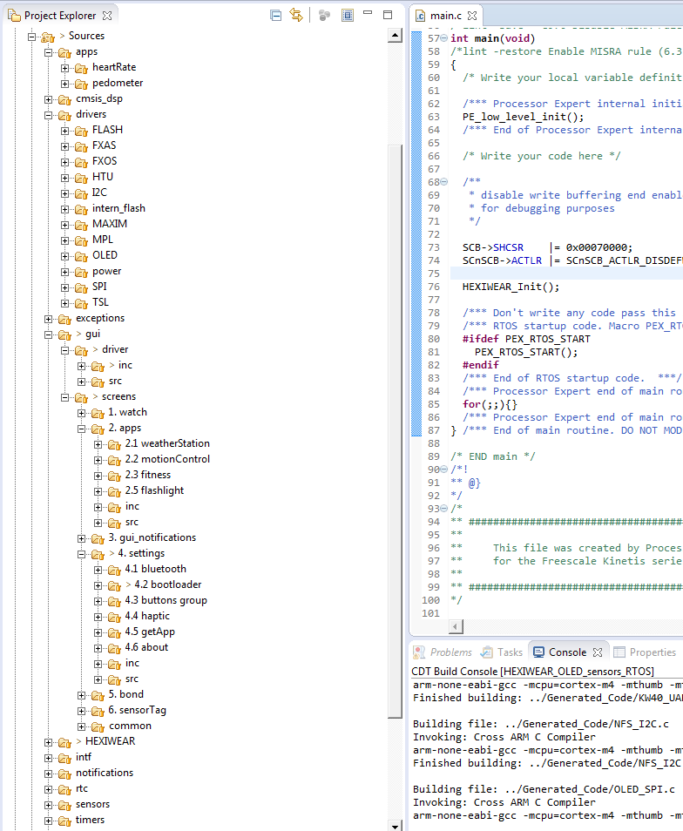
HEXIWEAR Firmware Structure

Slide 39
HEXIWEAR Firmware Structure
Main components:

Slide 40
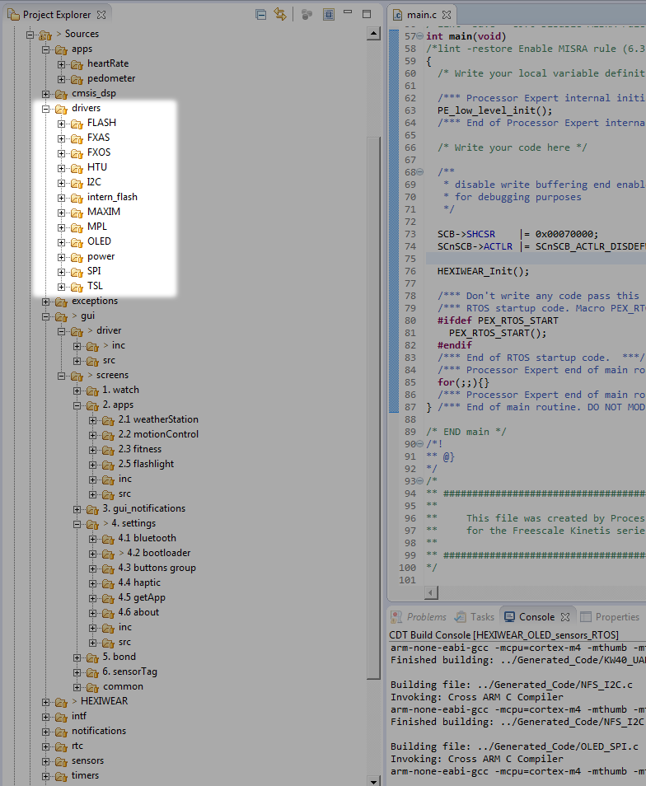
HEXIWEAR Firmware Structure
Main components:
Drivers

Slide 41
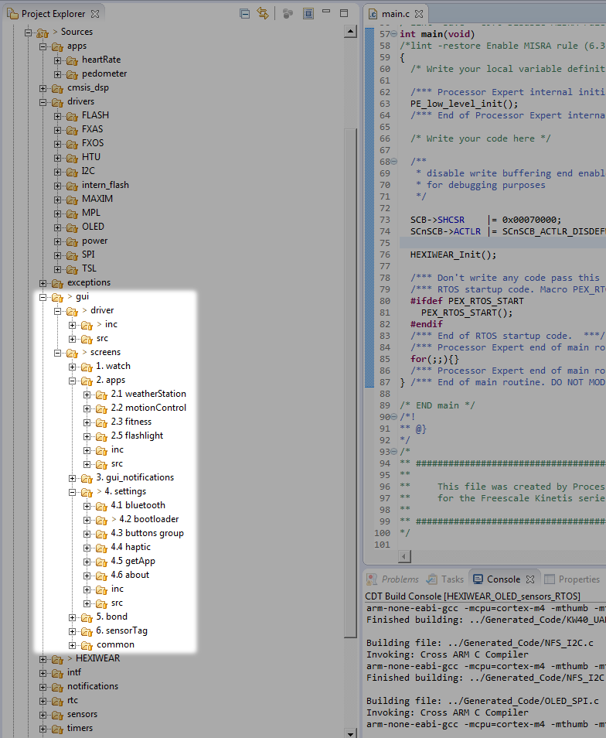
HEXIWEAR Firmware Structure
Main components:
Drivers
GUI

Slide 42
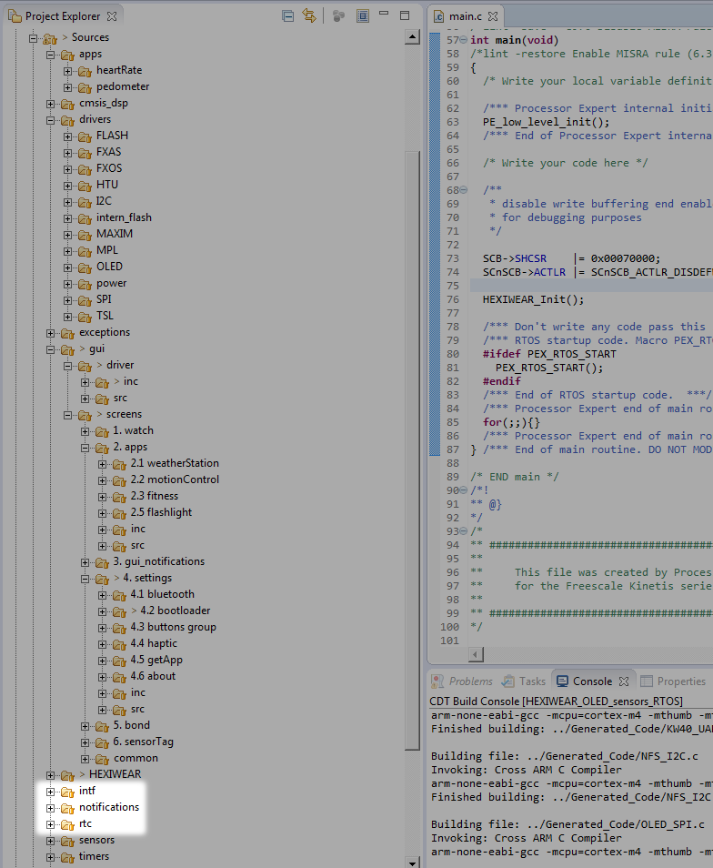
HEXIWEAR Firmware Structure
Main components:
Drivers
GUI
Communication interface
Notifications’ display
Clock

Slide 43
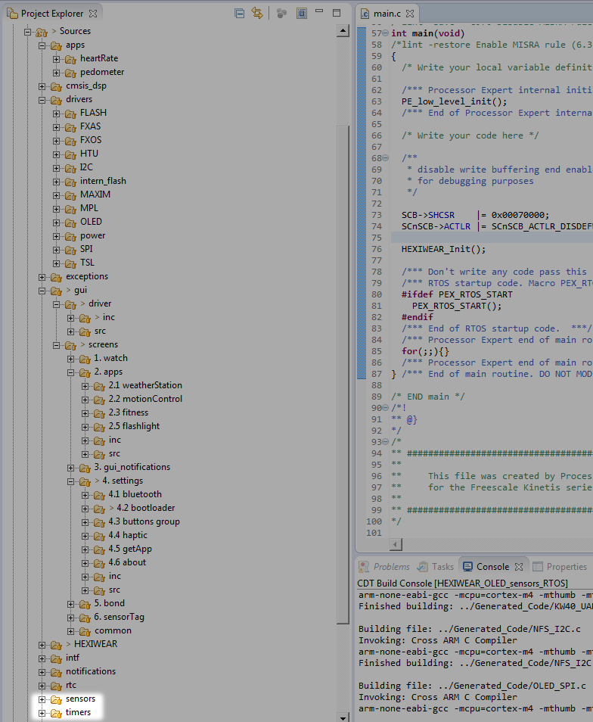
HEXIWEAR Firmware Structure
Main components:
Drivers
GUI
Communication interface
Notifications’ display
Clock
Sensor processing

Slide 44
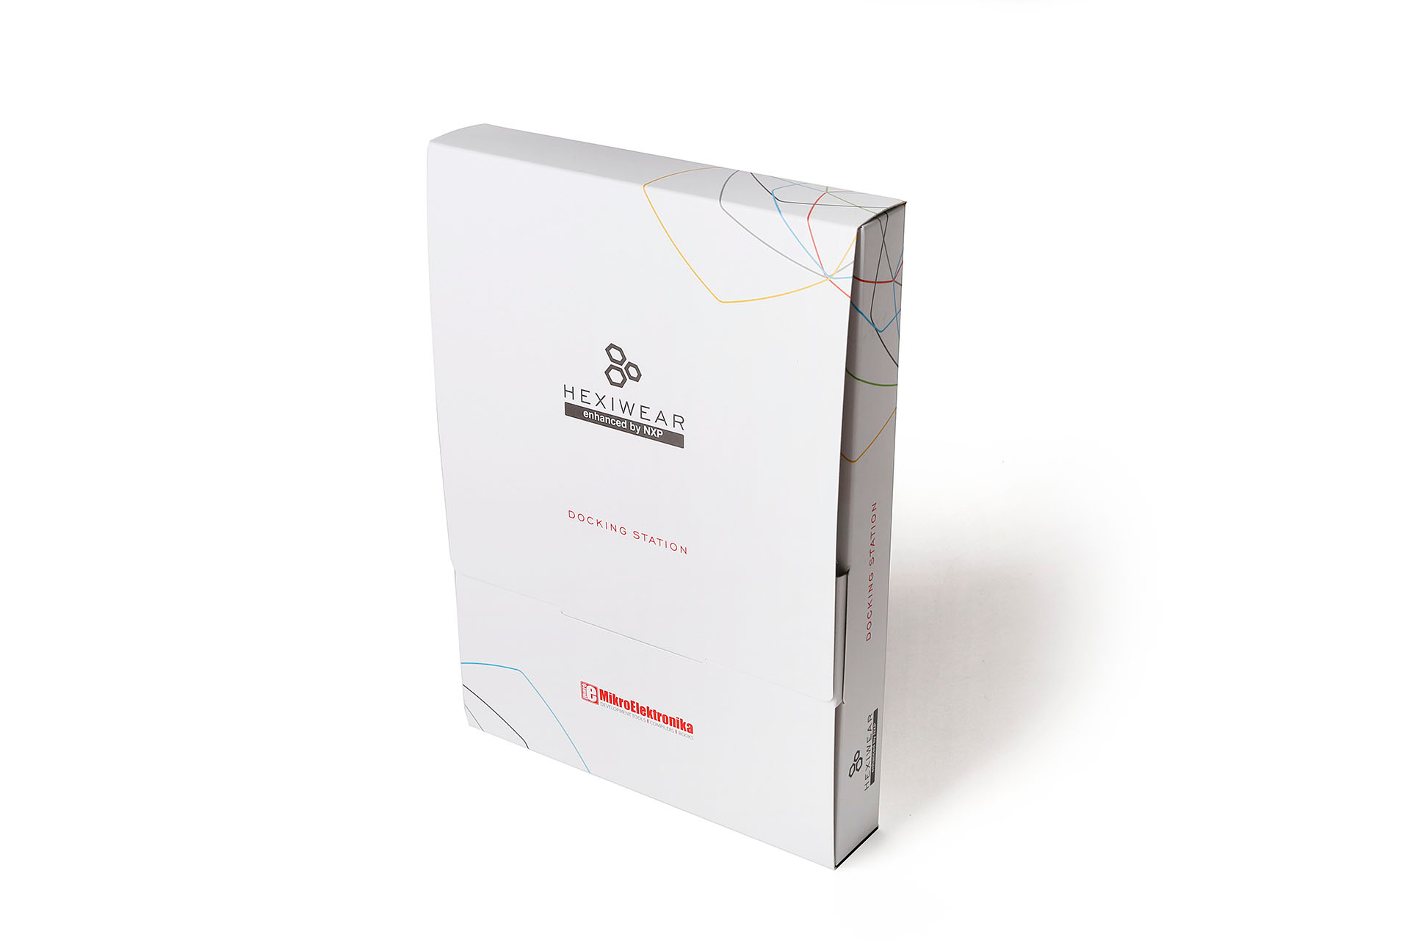
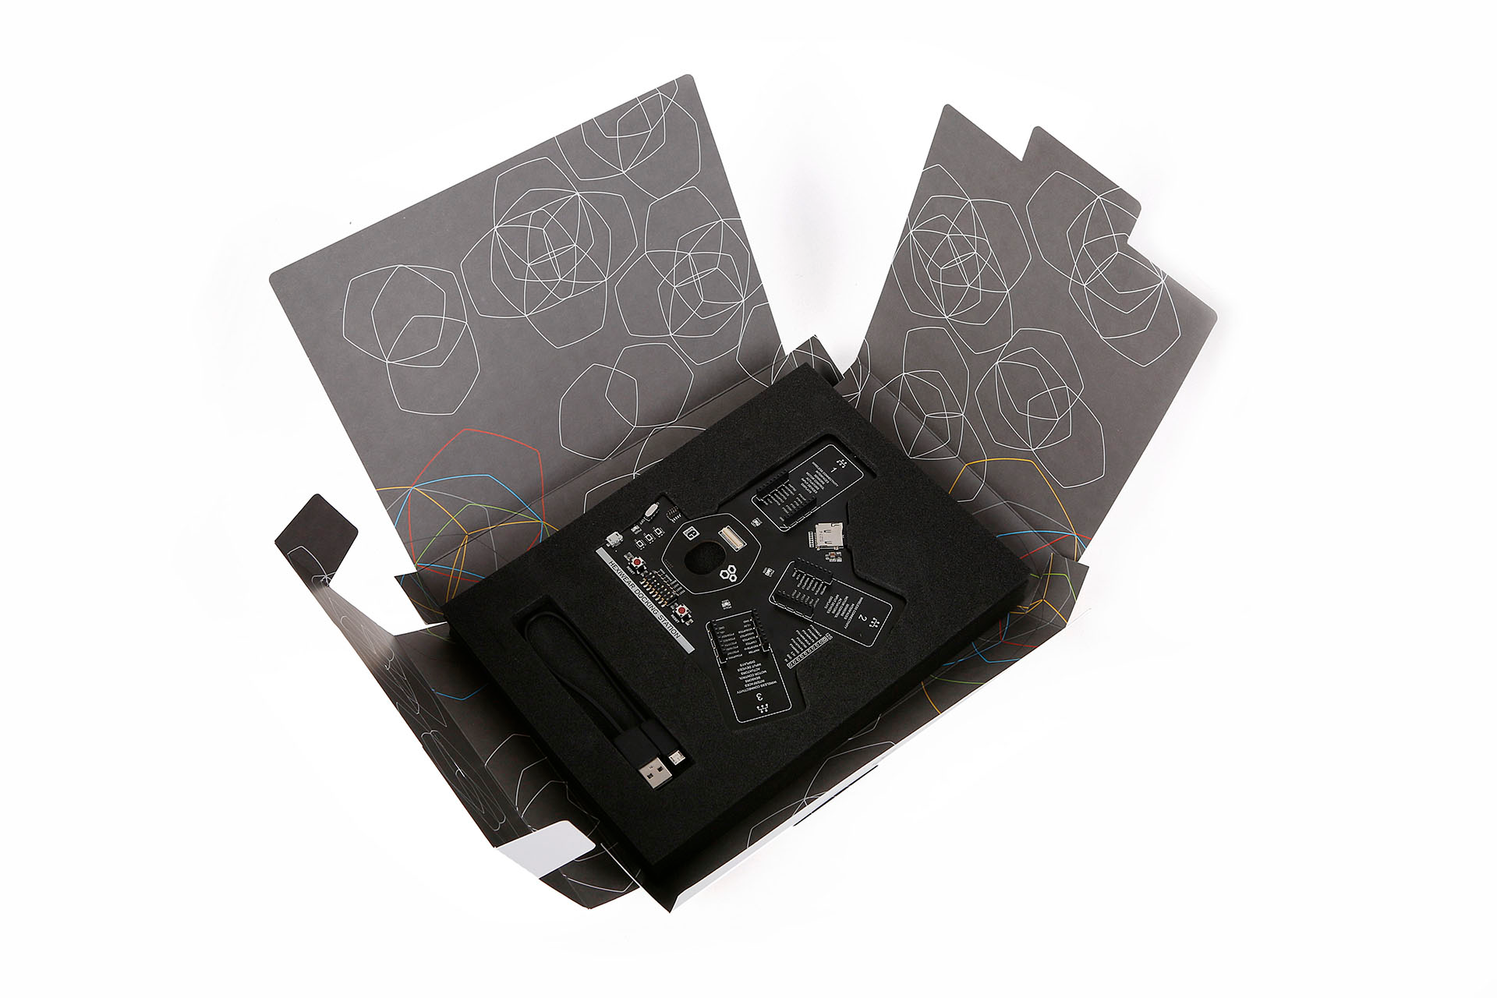
HEXIWEAR Docking Station pack
When used together with its own Docking Station, Hexiwear's core functionality can be enhanced with hundreds of additional sensors, actuators and transceivers of all kinds.

Slide 45
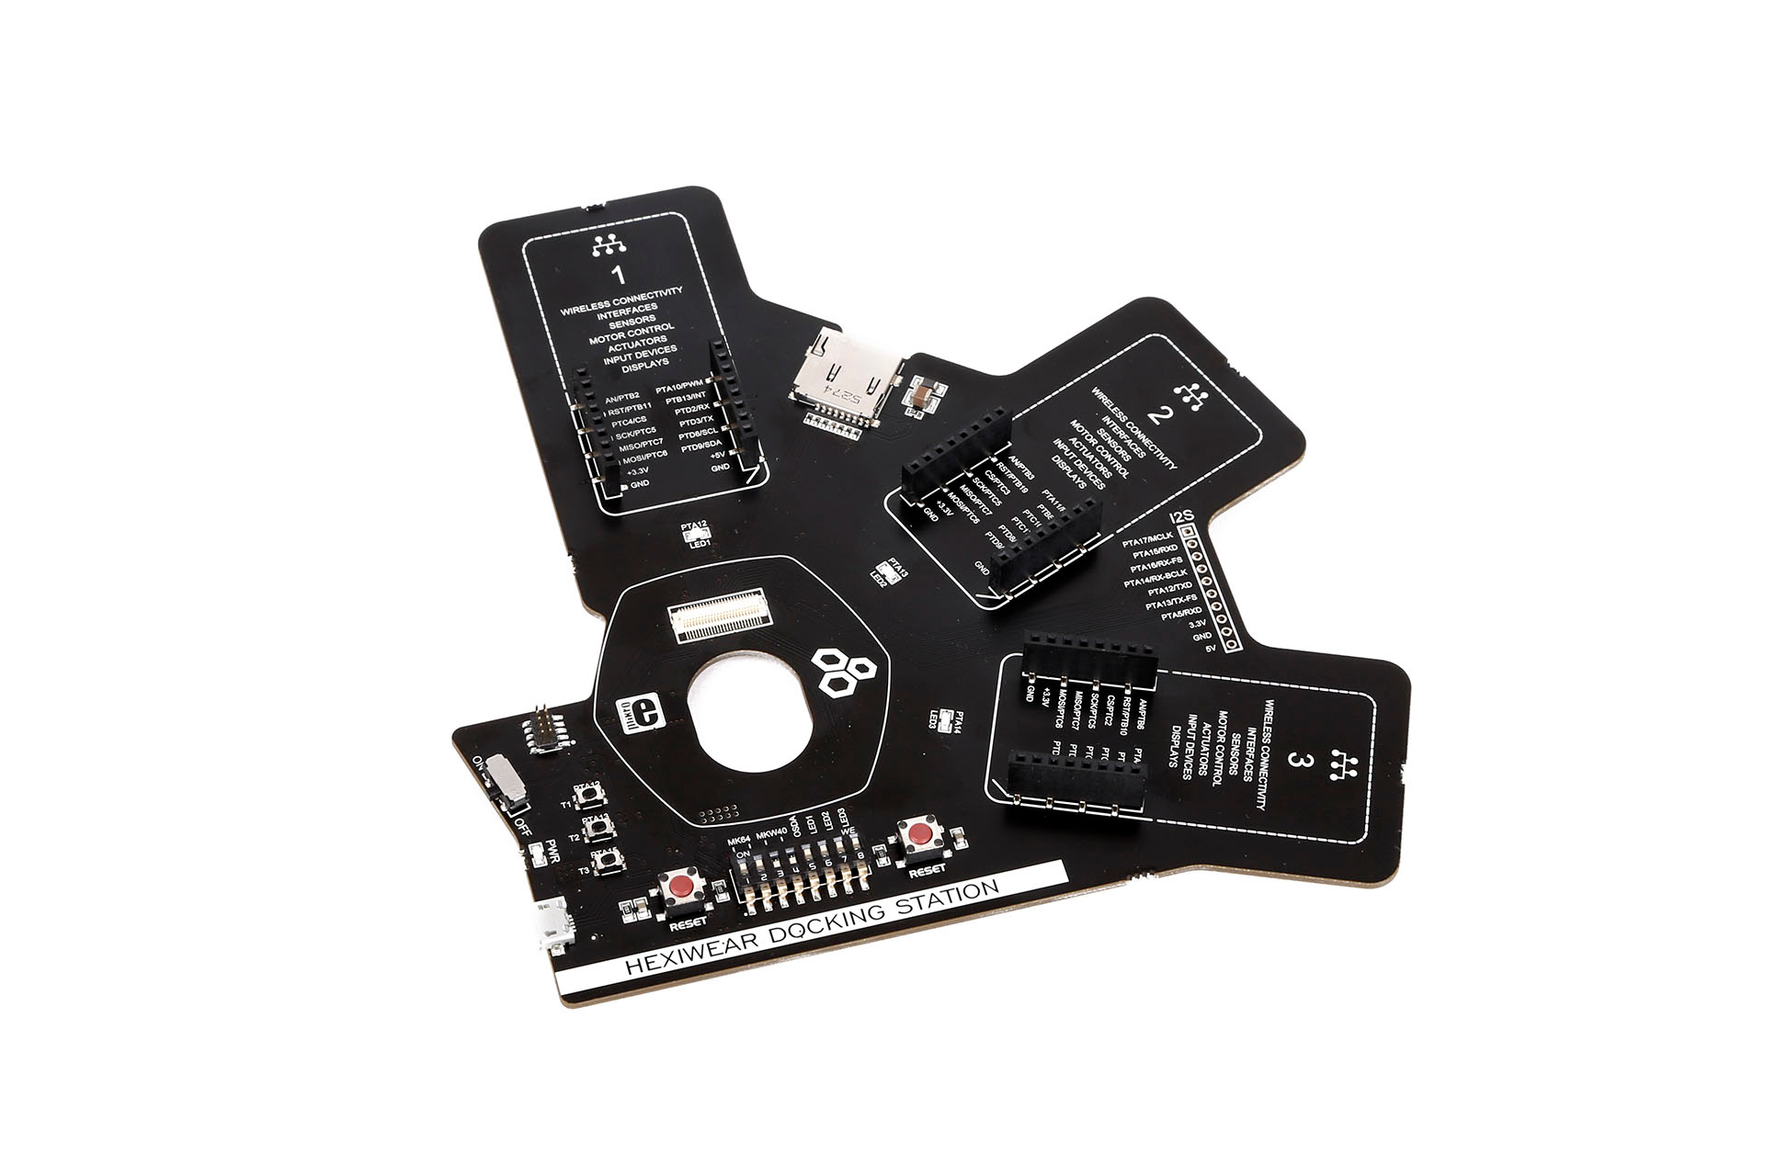
HEXIWEAR Docking Station
SD card slot
MikroBus Sockets
Programmer
I/O
Control

Slide 46
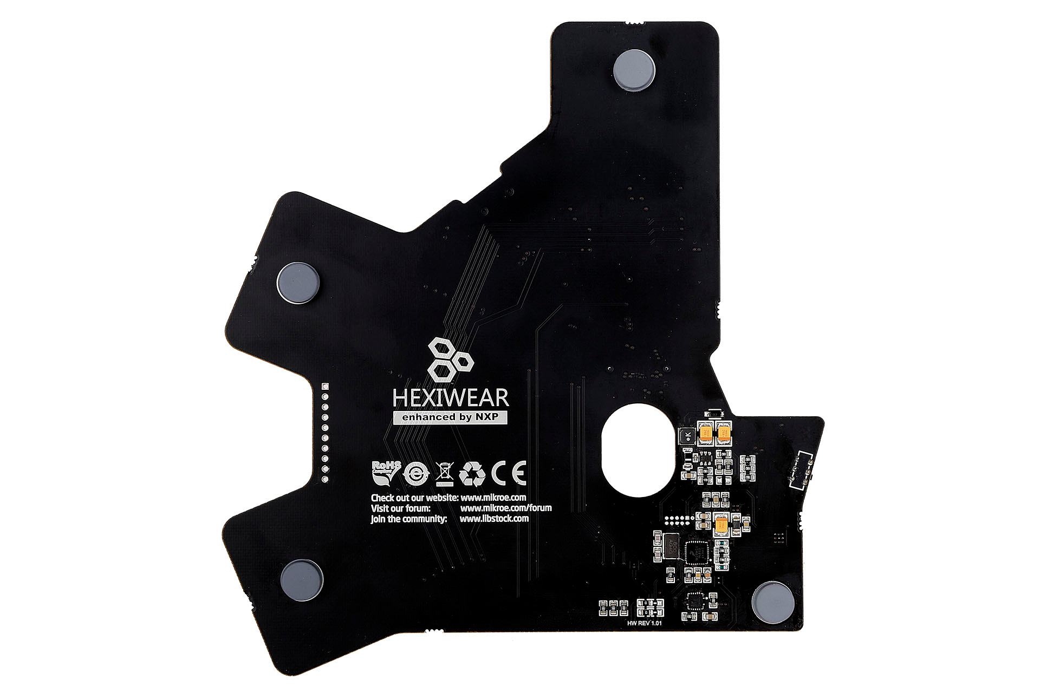
HEXIWEAR Docking Station
OpenSDA

Slide 47
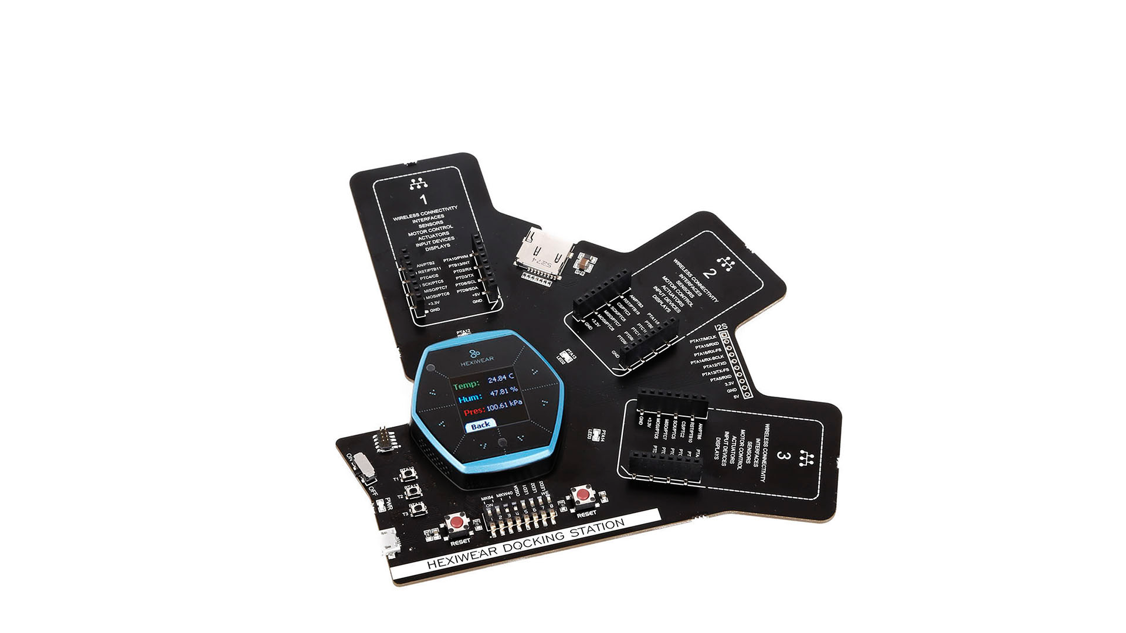






Slide 48


HEXIWEAR Resources
Public Repository @ Github https://github.com/MikroElektronika/HEXIWEAR
PCB project, Layouts, Schematics
MK64 & KW40 Firmware
How-to & General Documentation

Slide 49




HEXIWEAR Resources
Public Repository @ Github https://github.com/MikroElektronika/HEXIWEAR
User’s Guide @ mikroe wiki docs.mikroe.com/Hexiwear
Resource Collection Tool http://download.mikroe.com/setups/additional-software/resource-collection/resource-collection-tool-setup-v100.zip
Google Play & App Store https://itunes.apple.com/us/app/hexiwear/id1080657183?mt=8 https://play.google.com/store/apps/details?id=com.wolkabout.hexiwear

Slide 50




Exercise: Flashlight LED Tweaks

Slide 51
Exercise: Flashlight LED Tweaks

Slide 52


Exercise: Flashlight LED Tweaks

Slide 53
Exercise: Flashlight LED Tweaks

Slide 54

Exercise: Flashlight LED Tweaks

Slide 55


Exercise: Change Haptic Feedback Duration

Slide 56

Exercise: Add a new screen to HEXIWEAR menu

Slide 57
Relay Click Screen

Slide 58
Relay Click Screen
New folder here

Slide 59

Usual file structure

Slide 60

Usual file structure

Slide 61
Screen Data Structure
typedef struct GuiNavigation
{
struct GuiItem *up;
struct GuiItem *down;
struct GuiItem *left;
struct GuiItem *right;
} guiNavigation_t;
typedef struct GuiItem
{
guiNavigation_t navigation;
const uint8_t* image;
void (*initFunction)(void *param);
void (*createTaskFunction)(void *param);
void (*destroyTaskFunction)(void *param);
} guiScreen_t;

Slide 62
Screen Data Structure
guiScreen_t
guiScreen_t
typedef struct GuiNavigation
{
struct GuiItem *up;
struct GuiItem *down;
struct GuiItem *left;
struct GuiItem *right;
} guiNavigation_t;
typedef struct GuiItem
{
guiNavigation_t navigation;
const uint8_t* image;
void (*initFunction)(void *param);
void (*createTaskFunction)(void *param);
void (*destroyTaskFunction)(void *param);
} guiScreen_t;
guiNavigation_t
guiScreen_t
guiScreen_t
*initFunction
*createTaskFunction
*destroyTaskFunction
*image
guiScreen_t

Slide 63

Relay Click Screen
relay_click_private.h
relay_click.h
relay_click_resources.c
relay_click_objects.c
relay_click_driver.c

Slide 64

Relay Click Screen
relay_click_private.h
relay_click.h
relay_click_resources.c
relay_click_objects.c
relay_click_driver.c

Slide 65

Relay Click Screen
Resource Collection Tool http://download.mikroe.com/setups/additional-software/resource-collection/resource-collection-tool-setup-v100.zip
relay_click_private.h
relay_click.h
relay_click_resources.c
relay_click_objects.c
relay_click_driver.c
Resource Collection Tool
Bitmap images
Bit depth 16-bit
Resolution 96 ⨉ 96

Slide 66

Relay Click Screen
relay_click_private.h
relay_click.h
relay_click_resources.c
relay_click_objects.c
relay_click_driver.c

Slide 67

Relay Click Screen
relay_click_private.h
relay_click.h
relay_click_resources.c
relay_click_objects.c
relay_click_driver.c

Slide 68

Relay Click Screen
relay_click_private.h
relay_click.h
relay_click_resources.c
relay_click_objects.c
relay_click_driver.c

Slide 69


Relay Click Screen
relay_click_private.h
relay_click.h
relay_click_resources.c
relay_click_objects.c
relay_click_driver.c

Slide 70
Relay Click Screen
relay_click_private.h
relay_click.h
relay_click_resources.c
relay_click_objects.c
relay_click_driver.c
Before the screen is displayed

Slide 71
Relay Click Screen
relay_click_private.h
relay_click.h
relay_click_resources.c
relay_click_objects.c
relay_click_driver.c
After the screen is displayed

Slide 72
Relay Click Screen
relay_click_private.h
relay_click.h
relay_click_resources.c
relay_click_objects.c
relay_click_driver.c
Before a newer screen is displayed

Slide 73

Relay Click Screen
relay_click_private.h
relay_click.h
relay_click_resources.c
relay_click_objects.c
relay_click_driver.c

Slide 74

Relay Click Screen
relay_click_private.h
relay_click.h
relay_click_resources.c
relay_click_objects.c
relay_click_driver.c
Add LED functionality

Slide 75

HEXIWEAR Power User Pack
The Power User Pack is for those who want to use Hexiwear to its full potential.

Slide 76





HEXIWEAR Color Pack

Slide 77

Time for questions
Thank you!

